Slide 1
Rugby Leaders Course

Slide 2
Staff
Course Leader:
James Leppard
Role:
To lead course, support coach educators, and be a point of reference for any complaints or issues.
Ensure quality assurance of all course organisation, deliveries and assessment procedures.
Role:
To provide you with opportunities to coach
Feedback on improving your coaching skills
Feedback on improving your technical / tactical knowledge

Slide 3
Housekeeping

Slide 4
Learning Outcomes Pt.1
By the end of the first section you will be able to –
Understand and Provide a safe and fun environment to learn.
Understand the benefits of coaching through games.
Understand the benefits of ‘Whole Player, Whole Coach approach

Slide 5
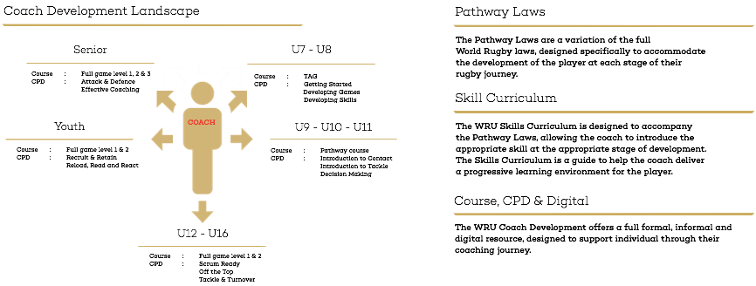
Coaching Landscape

Slide 6
Ice Breaker
In your groups individually share your answers to the following –
What inspired you to coach?
Why are you attending the TAG course?
What do you think you will get out of the course?
What can you get out of Rugby other than playing?

Slide 7
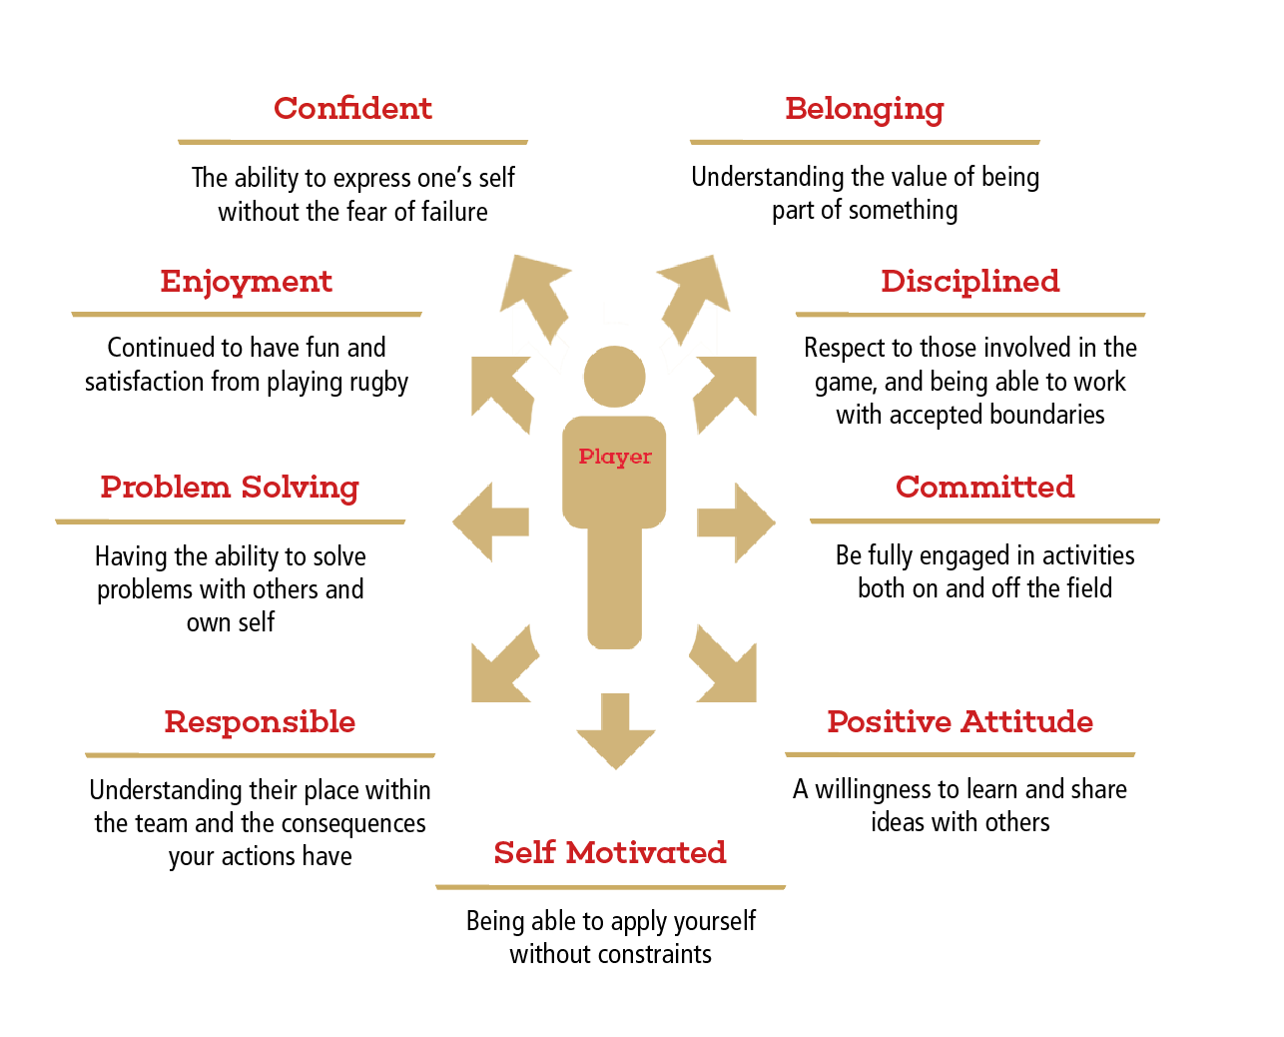
Whole Player

Slide 8
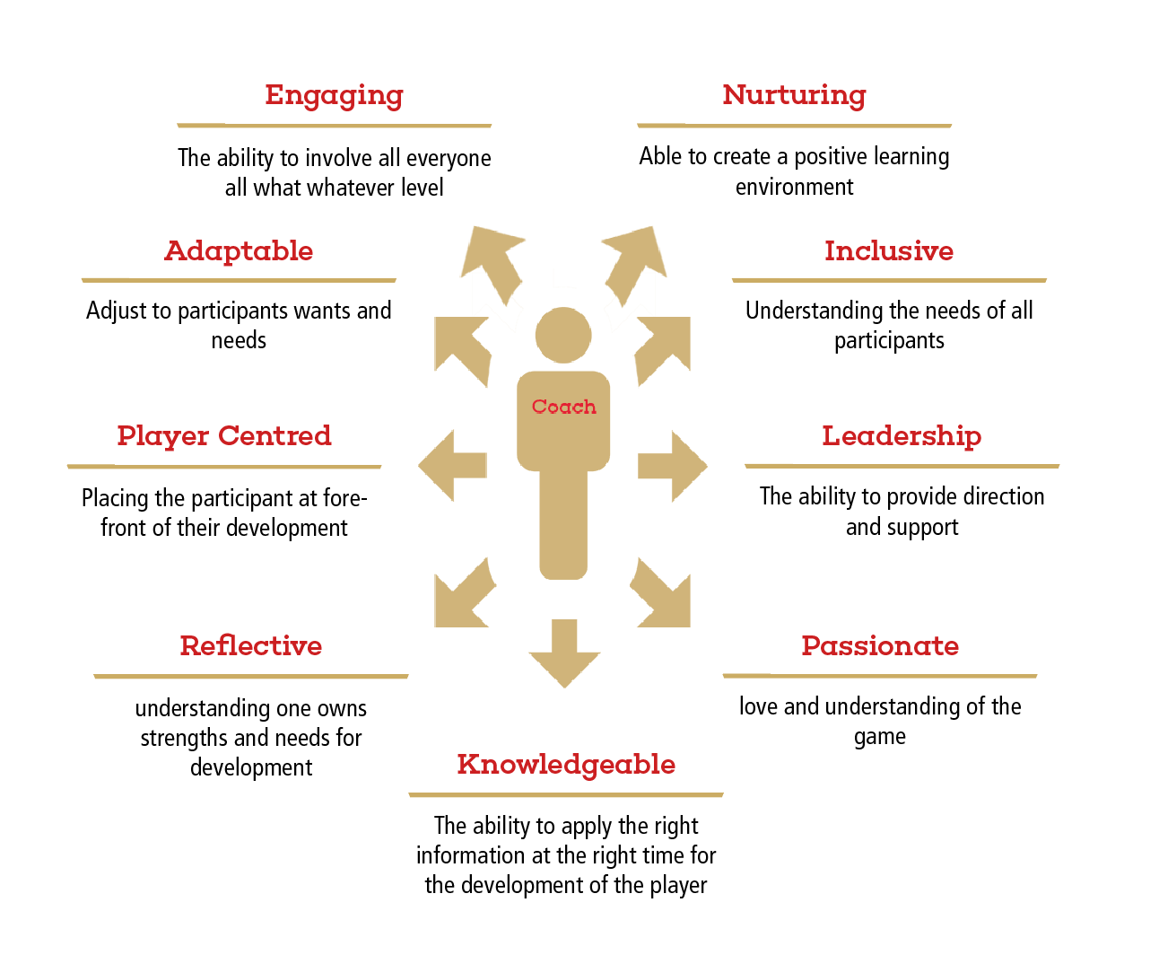
Whole Coach

Slide 9
Best Coaching Practice
Task 1:
If we were to run a successful coaching session, what would we need to consider?
Task 2:
Watch the video and list all the coaching points you see.

Slide 10
Best Coaching Practice

Slide 11
Best Coaching Practice
To establish a successful TAG session, the coach should adopt the following coaching tips to ensure the best environment is achieved for all players to learn and have fun.
1. Be prepared for when they arrive, have the first game/ warm up ready to go
2. Be welcoming, enthusiastic and remember to smile.
3. Keep explanations simple, encourage them to ask questions.
4. Be inclusive, involve all players
5. Always encourage and praise
6. Use a whistle to gain attention, try not to shout or lose patience
7. Avoid highlighting errors or weaknesses, and do not use negative words
8. Use your players names if you don’t know them get to know them don’t make one up

Slide 12
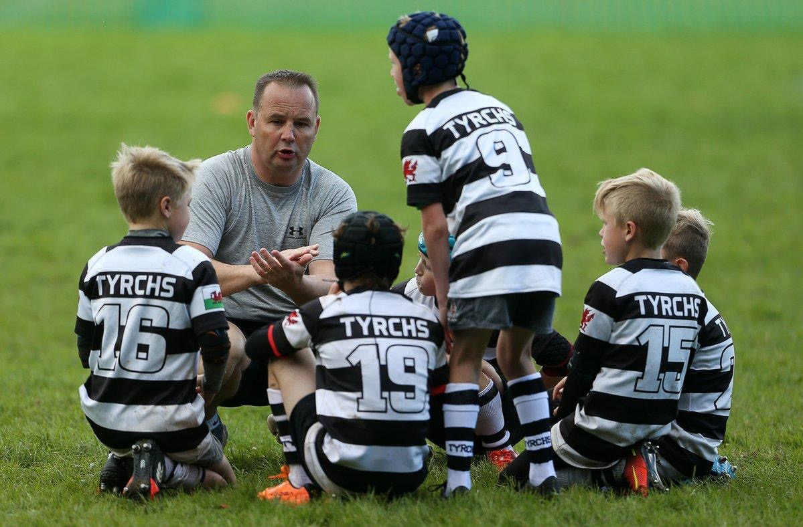
Coaching Through Games
A
P
E
S
Active
Purposeful
Enjoyable
Safe

Slide 13
Session Structure
Warm
up
Whole
Part
Whole
Dynamic Warm up, with lots of fun activities
Introduce a technique through team games
Break the technique down in smaller groups
Return to the game to challenge the technique

Slide 14
Session Planning
Plan:
Plan your session in advance to maximize the experience for all participants
Plan
Do:
Run your session as close to the session plan as possible and take mental notes of what is going well and what can be developed
Review
Do
Review:
Following the session, think about the mental notes you made and how they can potentially influence your next session

Slide 15
Learning Outcomes Pt.2
By the end of the second session you will be able to –
Understand the role of an official and fair play in rugby.
Understand how to plan and run a rugby event.

Slide 16
WRU Leaders Award
Fair Play & Role of the Official

Slide 17
Fair Play
In Groups, define what you think is ‘fair play’?

Slide 18
Fair Play
In ethics, the concept of fairness involves treating everyone equally and impartially.
'Fair play' is usually understood to mean using only tactics that are in accord with the spirit of the sport.

Slide 19
What are the 5 basic principles of fair play?

Slide 20
Principles of Fair Play
Respect the Rules
Respect the Opponents
Respect the Officials and their decisions
Have everyone participate
Maintain self control at all times

Slide 21
Sports Leaders Responsibility
Sports Leaders must take responsibility for ‘fair play’ in the sessions they lead.
Some ways to do this are:
Make sure everyone understands the rules
Ensure everyone follows the rules
Make sure no one is treated unfairly
Make sure that everyone feels involved

Slide 22
All parties involved in Rugby have a collective responsibility to ensure fair play
Discipline is paramount to maintain safety
Any form of foul play or abuse should not be tolerated

Slide 23
Role of the Official
What is the role of the official?
Officials undertake an important role in the staging of competitions. They provide leadership and guidance to participants in a facilitative manner, ensuring that the competition is conducted in a safe and fair manner.(UNICEF)

Slide 24
Officials
What are the qualities needed to be an official?
Trustworthy - honest and impartial
Responsible - have integrity and take the role seriously
Competent - have and are further developing the skills and knowledge for the task

Slide 25
Tag Rugby Rules Test
Q1 |  |  | Q7 |  |  | Q13
Q2 |  |  | Q8 |  |  | Q14
Q3 |  |  | Q9 |  |  | Q15
Q4 |  |  | Q10 |  |  | Q16
Q5 |  |  | Q11 |  |  | Q17
Q6 |  |  | Q12 |  |  | Q18

Slide 26
Tag Rugby Rules Test
Q1 | A |  | Q7 | B |  | Q13 | A
Q2 | C |  | Q8 | B |  | Q14 | C
Q3 | C |  | Q9 | E |  | Q15 | A
Q4 | B |  | Q10 | B |  | Q16 | B
Q5 | B |  | Q11 | C |  | Q17 | C
Q6 | A |  | Q12 | D |  | Q18 | C

Slide 27
EVENT PLANNING

Slide 28
Festival vs. Tournament
Discuss the following in groups of 4/5:
What is a Festival?
How does a Festival differ from a tournament?
Flipchart your answers and feedback to the rest of the group

Slide 29
Festival vs. Tournament
Festival – Teams are placed into participation pools and given the maximum opportunity in the allotted time frame to compete against other teams. No scores or outcomes are recorded from the games.
Tournament – Teams are placed into participation pools or leagues to compete against other teams. Scores from each game are recorded and points are awarded for the outcome of the game. Points are added up and an overall standing is established within the pool from 1st place to last place.

Slide 30
Event Planning
In groups, decide what arrangements or considerations need to be made in order to operate a successful event.
When discussing, consider the following categories:
Before the event
During the event
After the event
Responsibilities
Use your workbook to record your discussion comments and feedback to the rest of the group.

Slide 31
Event Planning Considerations
Some questions need to be asked before organising the event:
Is the venue suitable and safe?
How many teams are arriving?
How long will they be in attendance?
How many games will need to be played?
Is there enough space to play?
Who will be needed to help and what will they have to do?

Slide 32
Roles of the Volunteer
What roles may a volunteer carry out when running a sports event?
Sports Leaders/Coaches
Referees
Pitch organiser
Score keepers
Score Runners
Time Keeper
Registration desk operator
Toilet supervisors/runners
First aiders
Litter pickers
Etc…

Slide 33
Venue Preparation
What arrangements / facilities would arriving teams need to be made aware of if they have never visited the venue before?
Registration Desk
First Aid Tent
Pitch Numbers
Toilets
Car Park
Bins
Fire/Emergency assembly points
Each item should be signposted for participants to easily navigate the venue, especially pitch numbers.
You will have a home study task to complete based on Health and Safety considerations

Slide 34
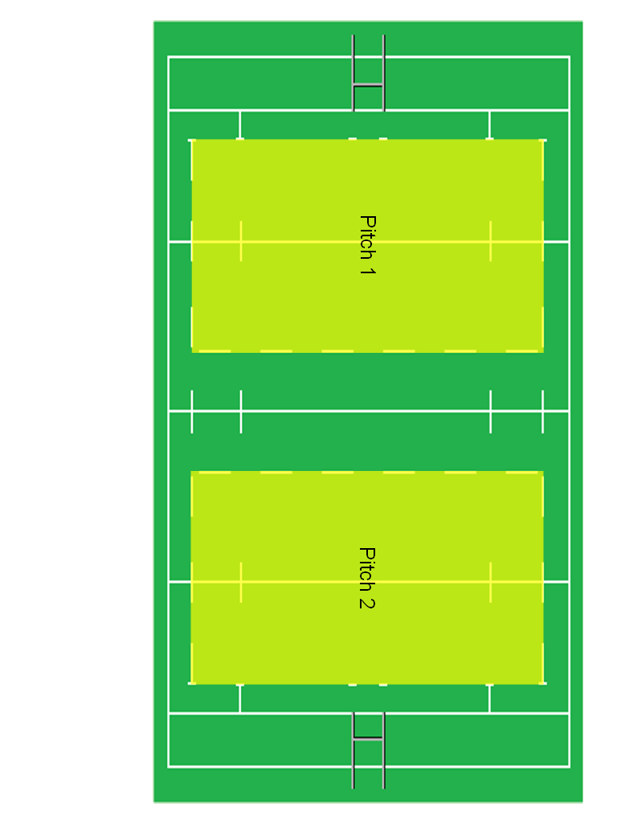
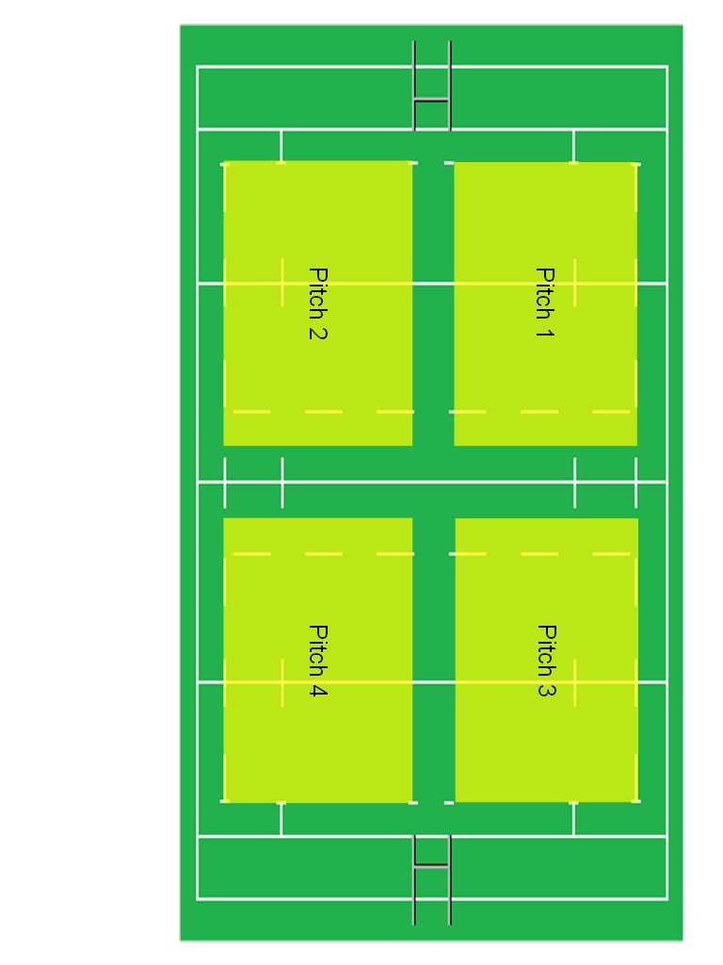
Pitch Management
1 Field, 2 Pitches
1 Field, 4 Pitches

Slide 35
Fixture Planning Task
You will be allocated one of the following scenarios:
You are running a festival and have one full size rugby field available. The festival is to last no longer than one hour and you have six teams arriving, two of which are from the same school. How would you organise the teams to maximise participation?
You are running a festival and you have a sports hall available. The festival is to last no longer than one hour and you have five teams arriving. How would you maximize their participation?
You are running a festival and have a field with no markings; the size of the field is 170m x 50m allowing safe proximity from the boundaries. There are 15 teams arriving and are available for one and a half hours. How would you maximise their participation?
You are running a tournament with 7 participating teams and have 1 full size rugby field available. Teams are available for 2 hours. How would you organise the competition to find a winner?
Refer to “EVENT PLANNING – PLAYING MATRIX” page to complete the task,
Using “EVENT PLANNING TASK” page, read the task and organise the event as described.

Slide 36
Event Invitation
Having planned and organised your event, the invitation is all important to ensuring the arrival of the participating teams.
What information needs to be provided in an event invitation?
You will have a home study task to complete based on event invitation.

Slide 37
Event Review
It is important that as an organising group, that your event is reviewed, in order to improve the operation / experience for the next event.
What should be the outcome of a review process?
What questions could be asked about the whole process of organising an event?
Located in your workbooks is an example event review form.
After you have conducted an event, complete the Plan – Do – Review cycle. Convene a meeting and complete the form on page in your workbook to action plan for your next event.

Slide 38
Summary
What is the difference between a Festival and a Tournament?
What are some of the organisational requirements of an event?
What do you now understand about the use of participation and scoring matrices?
What is some of the key information to be placed in an event invitation?

Slide 39
Course Reflection
Please answer the following reflection questions:
What did you learn?
What did you find interesting?
If you were to ask your coach educator one question regarding the TAG course, what question would you ask?

Slide 40
Course Learning Outcomes
By the end of the course you will be able to –
Provide a safe and fun environment to learn.
Ability to coach and understand the benefits of coaching through games.
Understand the benefits of ‘Whole Player, Whole Coach’
Understand the role of an official and fair play in rugby.
Understand how to plan and run a rugby event.

Slide 41
What next?
Continue your development:
WRU CPD U7 - U8:
Getting Started
Developing Game
Developing Skills
U8 –U9 Transition event
Next WRU Course:
Coaching Early Contact

