Slide 1
Rugby Leaders Course
Notes:
Those on the training need a copy of the workbook and the tag delivery aid

Slide 2
Resources
Course Power Point
PDF of Learner Workbook
TAG delivery notes
Tutor Notes Modules

Slide 3
Workshop Learning Outcomes
By the end of the workshop you will be –
Familiar with the content
Understand your role in the delivery
Able to run a rugby leaders course.

Slide 4
Rugby Leaders
What is it? - Introduction to coaching course delivered through the medium of the Tag Game.
Who is it for? – It is primarily for school/college pupils who can be deployed by you into Primary Schools.
How do I Deliver it? – This is totally up to you! Its 6hr in duration you can carve it up by whatever means suits you. Eg 1Day or 3x2hr sessions (after school )

Slide 5
Rugby Leaders – Why?
Growth of delivery skill set against educational standards, supported by CDOs
Potential to grow a community workforce within each Secondary School & stronger working relationships within Unitary Authorities
BENEFITS TO RUGBY OFFICERS
Rugby Leaders participants can cater for Primary School participation, and creating a wide base to participation pyramid
Grow wider skill set to prepare for progression into future/further roles

Slide 6
Organisation
You are keen to run your course what do you need to organise?
Who’s coming on it – How do you pick or advertise?
How many should I deliver too?
When are you going to run it?

Slide 7
Organisation
You have chosen your date/s you have your leaders
What next?
Its essential that you create a spreadsheet and capture Name and Date of Birth
You get all the candidates to register on the WRU Game locker. – They can do this first thing on the course.

Slide 8
Delivery
You should have all the necessary equipment required to deliver the CTLA. Eg. Balls, Cones, Tags & Whistles
Familiarise yourself with the programme – Read the tutor notes
I am also a resource for you if you need me to come out and watch your delivery I’m more than happy to.
Try and go and watch an experienced Hub Officer deliver.

Slide 9
TASTER SESSION
You will now have the opportunity to work closely with the materials and tasks that the pupils will participate in whilst you are delivering.
You may use your Rugby Leaders Award booklet and any other relevant resources to complete the tasks if you wish.
It is paramount the pupils complete their workbook as they progress and time is built in to each module to accommodate this process.

Slide 10
Set the Scene
You have decided to start in the classroom
You have your power point ready to go
What’s your biggest fear?

Slide 11
Before we start we - Must Do!
Get them to use their phones and register as coaches on the Game locker.
www.wrugamelocker.wales
Be friendly this is not boot camp and don’t forget engage with them as they are ultimately going to work for you so build relationships.

Slide 12
Coaching landscape and whole player whole coach
Great to use as an ice breaker
Explain that this is the start of a journey and as coaches we hold great responsibility.
Ask the questions ? What makes a good player? Draw out the responses don’t tell them the answers.
Repeat for the coach question

Slide 13
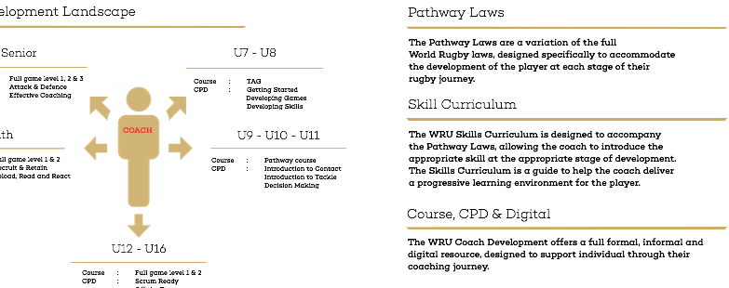
Coaching Landscape

Slide 14
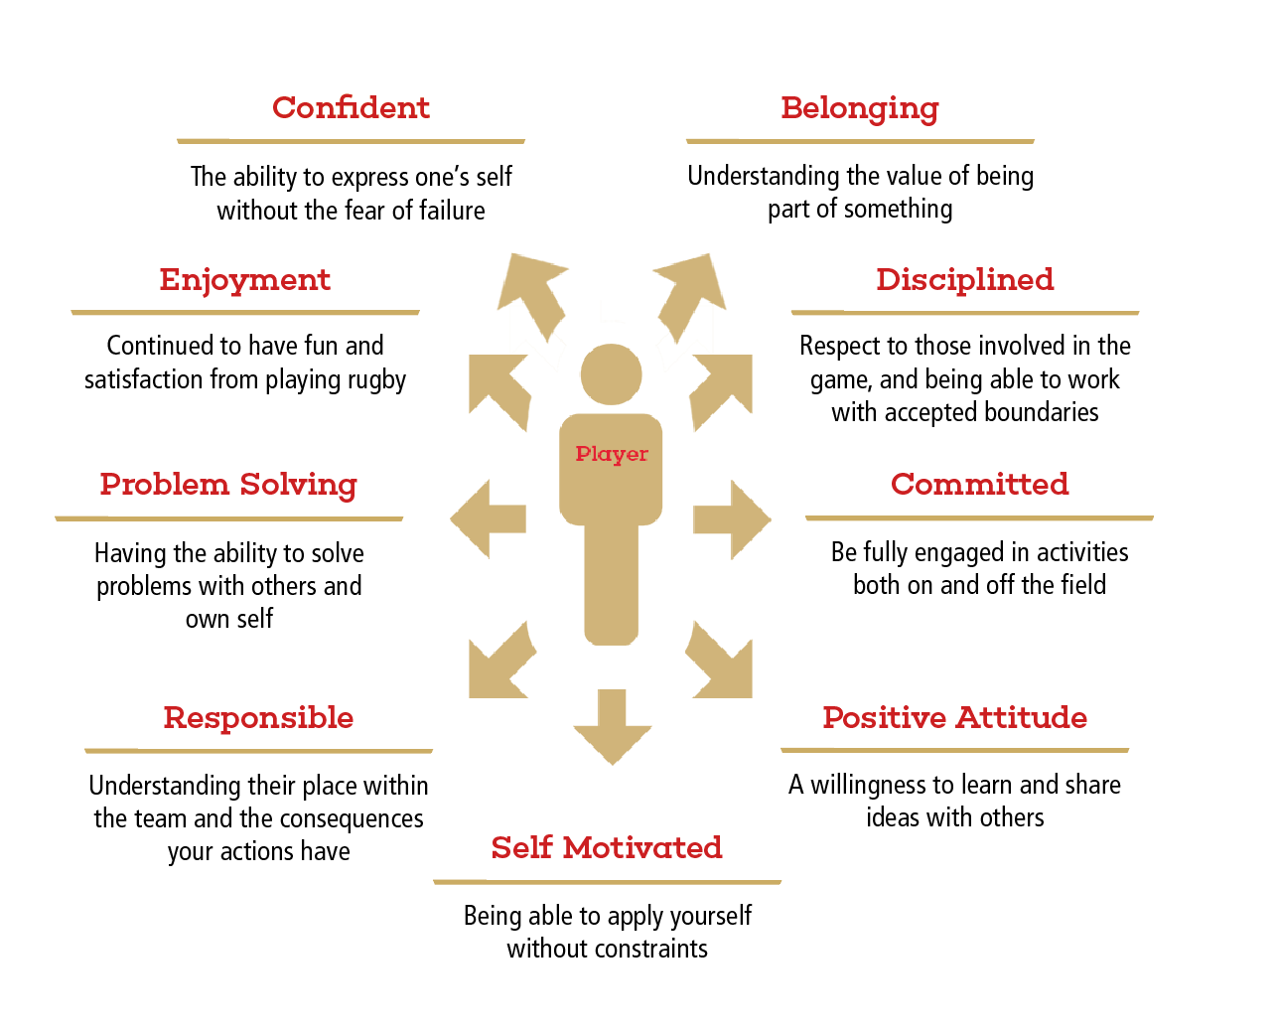
Whole Player
What are the characteristics that we want our players to have?

Slide 15
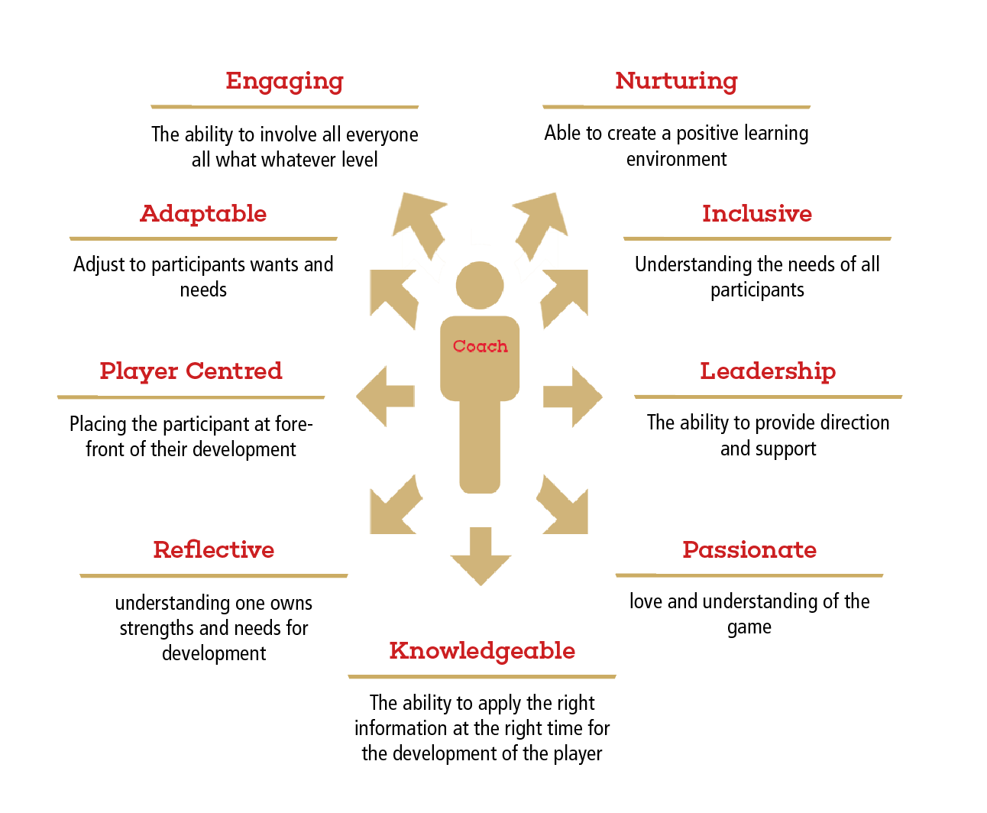
Whole Coach
What characteristics must we have as coaches to develop the whole player?

Slide 16
Best Coaching Practice
In groups complete Task 1:
If we were to run a successful coaching session, what would we need to consider?
How do we facilitate their answers?
I would suggest filling out a workbook yourself with the answers!!!

Slide 17
WRU Leaders Award
Fair Play & Role of the Official

Slide 18
Fair Play
In Groups, define what you think is ‘fair play’?
Have a go at filling it in the workbook
‘Fair Play or Sportsmanship expresses an aspiration or ethos that the activity will be enjoyed for its own sake, with proper consideration for fairness, ethics, respect. Being a "good sport" involves being a "good winner" as well as being a "good loser".’ (wikipedia)

Slide 19
What are the 5 basic principles of fair play?
Again have a go at filling in your workbook

Slide 20
Principles of Fair Play
Respect the Rules
Respect the Opponents
Respect the Officials and their decisions
Have everyone participate
Maintain self control at all times

Slide 21
Role of the Official
What is the role of the official?
Officials undertake an important role in the staging of competitions. They provide leadership and guidance to participants in a facilitative manner, ensuring that the competition is conducted in a safe and fair manner.(UNICEF)

Slide 22
Officials
What are the qualities needed to be an official?
Trustworthy - honest and impartial
Responsible - have integrity and take the role seriously
Competent - have and are further developing the skills and knowledge for the task

Slide 23
Have a go at the Tag Rugby Rules Test
Q1 |  |  | Q7 |  |  | Q13
Q2 |  |  | Q8 |  |  | Q14
Q3 |  |  | Q9 |  |  | Q15
Q4 |  |  | Q10 |  |  | Q16
Q5 |  |  | Q11 |  |  | Q17
Q6 |  |  | Q12 |  |  | Q18

Slide 24
Tag Rugby Rules Test
Q1 | A |  | Q7 | B |  | Q13 | A
Q2 | C |  | Q8 | B |  | Q14 | C
Q3 | C |  | Q9 | E |  | Q15 | A
Q4 | B |  | Q10 | B |  | Q16 | B
Q5 | B |  | Q11 | C |  | Q17 | C
Q6 | A |  | Q12 | D |  | Q18 | C

Slide 25
EVENT PLANNING

Slide 26
Fixture Planning Task
You will be allocated one of the following scenarios: in groups discuss and note
1. You are running a festival and have one full size rugby field available. The festival is to last no longer than one hour and you have six teams arriving, two of which are from the same school. How would you organise the teams to maximise participation?
2. You are running a festival and you have a sports hall available. The festival is to last no longer than one hour and you have five teams arriving. How would you maximize their participation?
3. You are running a festival and have a field with no markings; the size of the field is 170m x 50m allowing safe proximity from the boundaries. There are 15 teams arriving and are available for one and a half hours. How would you maximise their participation?
4. You are running a tournament with 7 participating teams and have 1 full size rugby field available. Teams are available for 2 hours. How would you organise the competition to find a winner?
Refer to “EVENT PLANNING – PLAYING MATRIX” page to complete the task,
Using “EVENT PLANNING TASK” page, read the task and organise the event as described.

Slide 27
Outdoor delivery
Planned, Organised and Confident
APES
Use questions to check learning/knowledge
Organisation - Area, H&S, Warm up, Groupings and the laws of the game – 45mins
Evasion – lots of games . Task – in groups devise an evasion game
Tagging - lots of games . Task – in groups devise a Tagging game
Catch Pass – How do we deliver this Give me an example
Refereeing – Give all Participants an opportunity to ref a game
Notes:
Organnisation – go through how you would deliver each one
Evasion – get them

Slide 28
UNEXPECTED CIRCUMSTANCES
In groups, you will be allocated 1 of the following scenarios.
You witness what you feel is bullying?
2 Pupils start fighting/arguing
School alter the facility which impacts on your module delivery due to another lesson taking priority
Pupils not listening
Pupils not completing work tasks in workbook
Pupil provides you with a response to a question that is inappropriate but relevant
How would you act / respond in this situation?
5 minutes to formulate a response

Slide 29
Organisation
You have completed your course – Well done Congratulations
What next?
Send over your spreadsheet to Me so that I can qualify your students……..if not I cannot give them the qualification.

