Slide 1
WRU
Educator
Framework

Slide 2
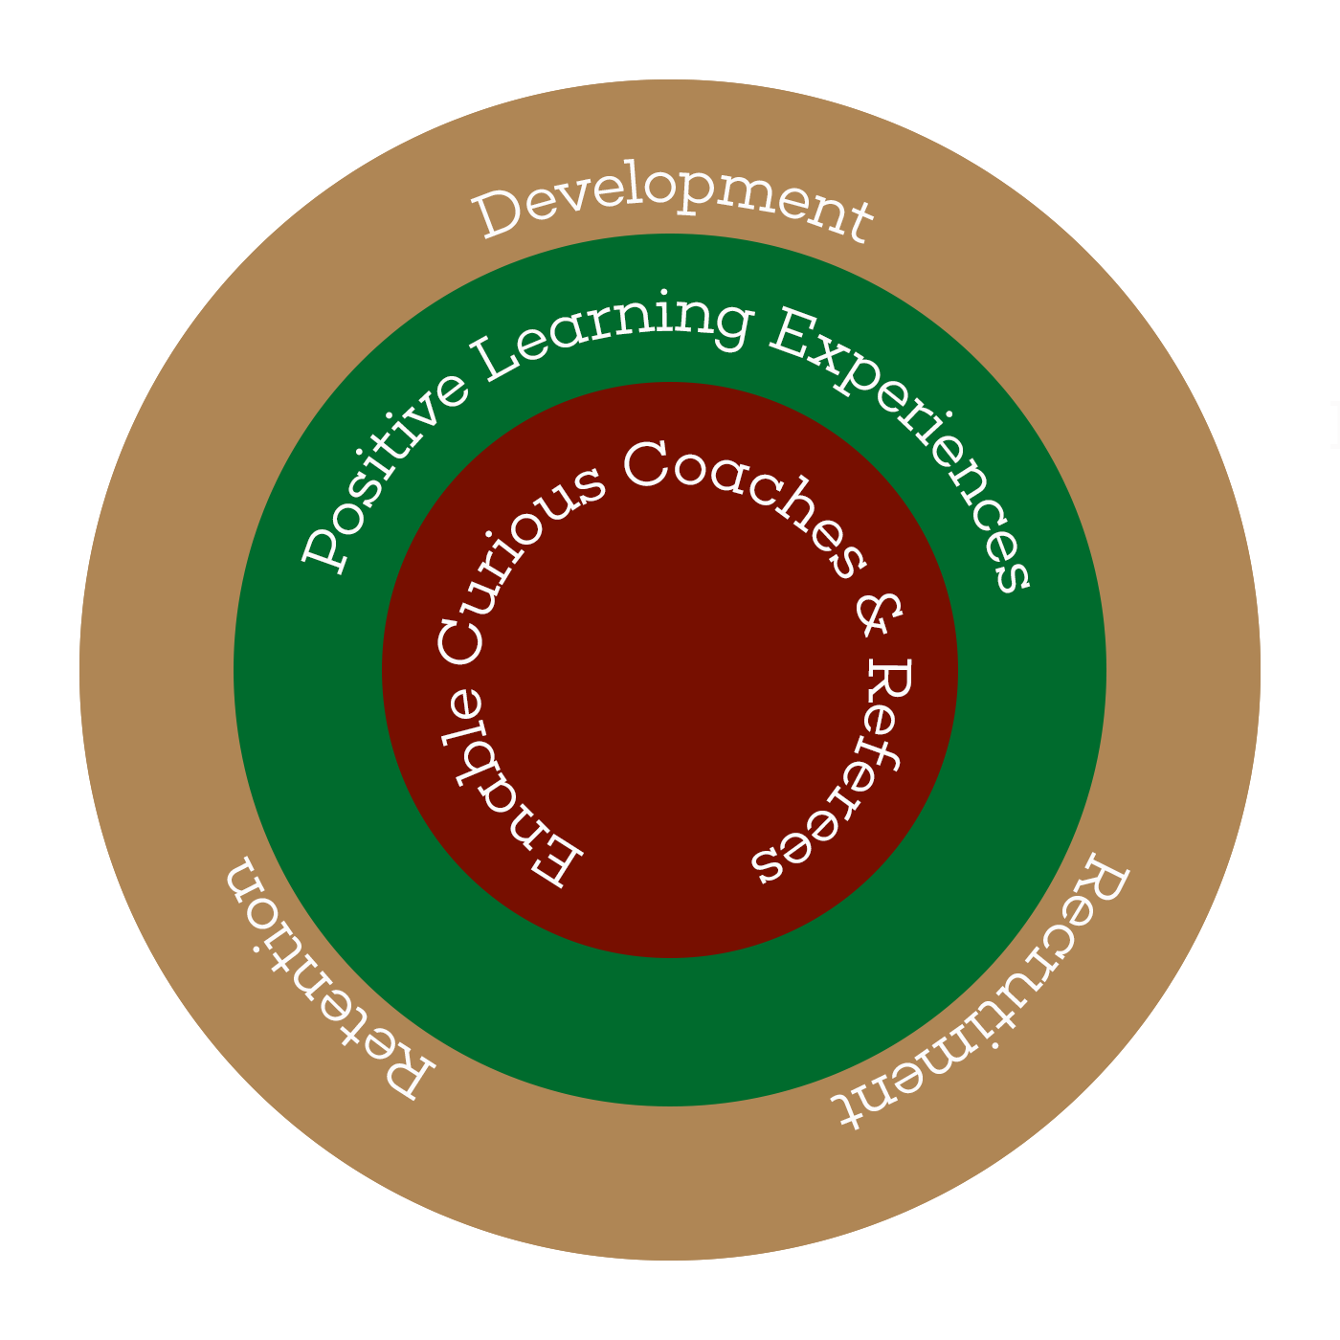
Why, How and What
Why:
Enable a Thriving Educator Workforce
The fundamental purpose of WRU Education is to enable a thriving workforce to deliver outstanding support and upskilling.
How:
Positive Learning Experiences
This will be achieved through the
Educator framework.
What:
Recruitment, Retention and Development
A modern accessible learning programme comprising of Formal, Informal and Digital platforms.

Slide 3
Why, How and What
The WRU will ‘Enable a Thriving Educator Workforce’ by providing ‘Positive Learning Environments’ through the ‘Educator Framework’ to ensure successful
‘Recruitment, Retention and Development’.

Slide 4
Why?

Slide 5
Why?
To enable a thriving educator workforce

Slide 6
Managing Change
To ‘Enable a Thriving Workforce’ WRU Education & Training will utilise the approach of the EAST principle to encourage change by making all support:
Easy
Attractive
Social
Timely
To ensure…
Belonging
Discovery
Achievement

Slide 7
How

Slide 8
How
Positive Learning Environments
Providing an environment that encourages learning through autonomy, a sense of belonging and capability to ensure continued personal development through the
Educator Framework.

Slide 9
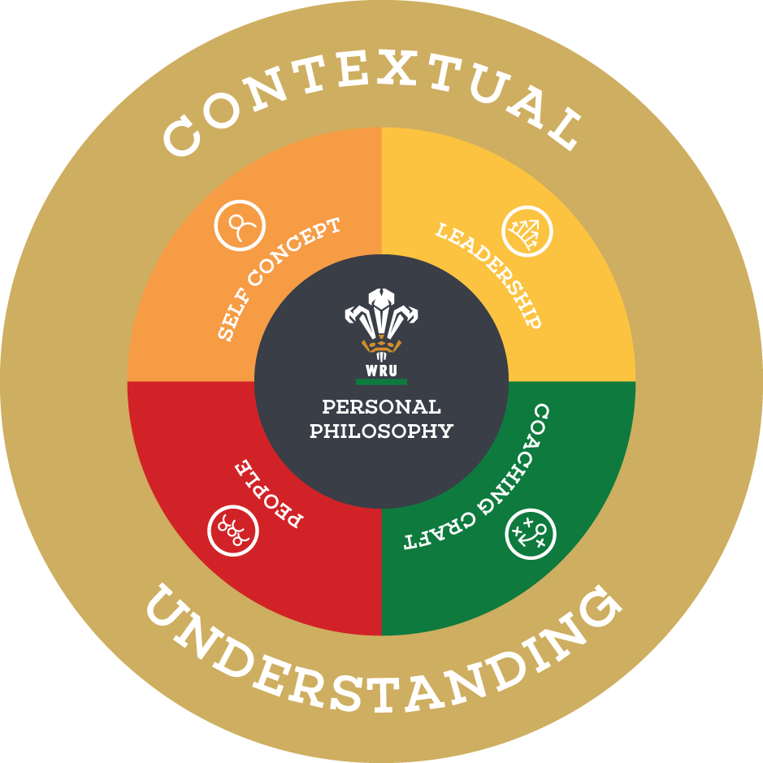
Educator Framework

Slide 10
Development Decision Making Model
Contextual Understanding
Context is King
The context which a coach and referee works within cannot be underestimated and must also be a consideration when meditating coach and referee identification, recruitment and development.
Various environments exist within the Welsh Rugby Union landscape. Educators within each of these contexts requires a certain set of principles that are outlined in this document. However, it is important to highlight that each context is very different in terms of challenge and task execution.

Slide 11
Development Decision Making Model
Craft
Thriving Learning Environments:
It is an educators role to continually manipulate the environment to ensure that a candidates learning and development is optimal especially through facilitation by acquiring strong questioning and listening skills
Educator Knowledge:
Sometimes referred to as the ‘detail’ educators need to be able to clearly articulate and critically evaluate individual and group performance
Profile Performance:
An understanding of what it takes to participate, underpinned by an ability to benchmark and review performance individually and collectively

Slide 12
Development Decision Making Model
Leadership
Vision:
Educators must form a vision and bring it to life. Vertical alignment is key and the educators role is to conceptualise this and create buy in
Inspirational:
Modern educators lead through transformational leadership. They inspire performance by empowering candidates within the environment to share in their own journey as a team
Persuasive:
To create buy in and collaboration it is imperative that educators have strong persuasive skills to ensure that they are constantly managing the environment
Problem Solving:
High performing educators make decisions based on sound judgement, critical thinking and with the intent of reducing the ambiguity

Slide 13
Development Decision Making Model
People
Relationships:
The most effective educators build positive, genuine and authentic relationships with candidates and support staff within their environment with the goal of maintaining a thriving culture
Collaboration:
Educators must collaborate with their management team, proactively involving and utilising others ideas and areas of expertise and maintain trust at all times
Emotional Intelligence:
Observing and monitoring a candidates emotions, motivation and feelings on a daily basis is a difficult skill, however being able to perform this as well as understand them is key
ID:
Critically evaluate what is constituted as ‘participation’ and then be able to envisage the fit of a candidate in their personal development

Slide 14
Development Decision Making Model
Self Concept
Self Aware:
Self-awareness is a key component of an emotionally intelligent educator and is critical to effective leadership
Reflective:
Expert practitioners have shown a clear characteristic of knowing their strengths and weaknesses and reflective practice allows an individual to engage with this process on a regular basis
Continuous Learner:
Having an unwavering desire for learning that is inextricably linked to personal development is key to delivery and future growth

Slide 15
Development Decision Making Model
Educator Principles
Craft
Leadership
People
Self Concept
Thriving Learning Environments
Educator Knowledge
Facilitating skills
Vision
Inspirational and
Persuasive
Problem Solving
Relationships
Collaboration
Emotional
Intelligence
Self Aware
Reflective
Continuous Learner

Slide 16
What

Slide 17
What
Recruit, Retain & Develop
Recruit:
Robust media support to highlight the benefits of participation and ensure that the WRU Education and Training supports the engagement of new educators.
Retain:
Providing a support network across all elements of the workforce to encourage continued participation.
Develop:
The WRU will provide formal, informal and digital education and training platforms to ensure educator development is maximised throughout our game.

Slide 19
Motivated learner
In the video there were 3 words that reinforced learning – pride satisfaction and accomplishment.
We have taken this concept and adopted our own words
Belonging
Discovery
Achievement
Give an example for each word in an educator scenario?
Notes:
Complete the task – if they are struggling get them to share their ideas – also choose someone to give an example of each again 5 mins

