Slide 1
WRU Educator
Notes:
This module should take 45 mins to deliver – don’t rush through the first 5 slides set the scene build rapport with them

Slide 2
Introduction
“Educating is the key to unlock the golden door to knowledge.”

Slide 3
welcome
The development of volunteers is at the forefront of the WRU Community Strategy and by having a WRU Educator Programme allows us to support all those involved in our game.
This programme is not a technical course about rugby.
This is a programme that will develop your skills and knowledge that will enable you to support all areas of our rugby community activities.
The programme will focus on the softer skills of educating and preparing you to deliver the WRU messages.
Notes:
Welcome the participants to the course, and introduce yourself and the co deliverers, set the scene about the course and mention its about the development of others to enable our game to thrive.

Slide 4
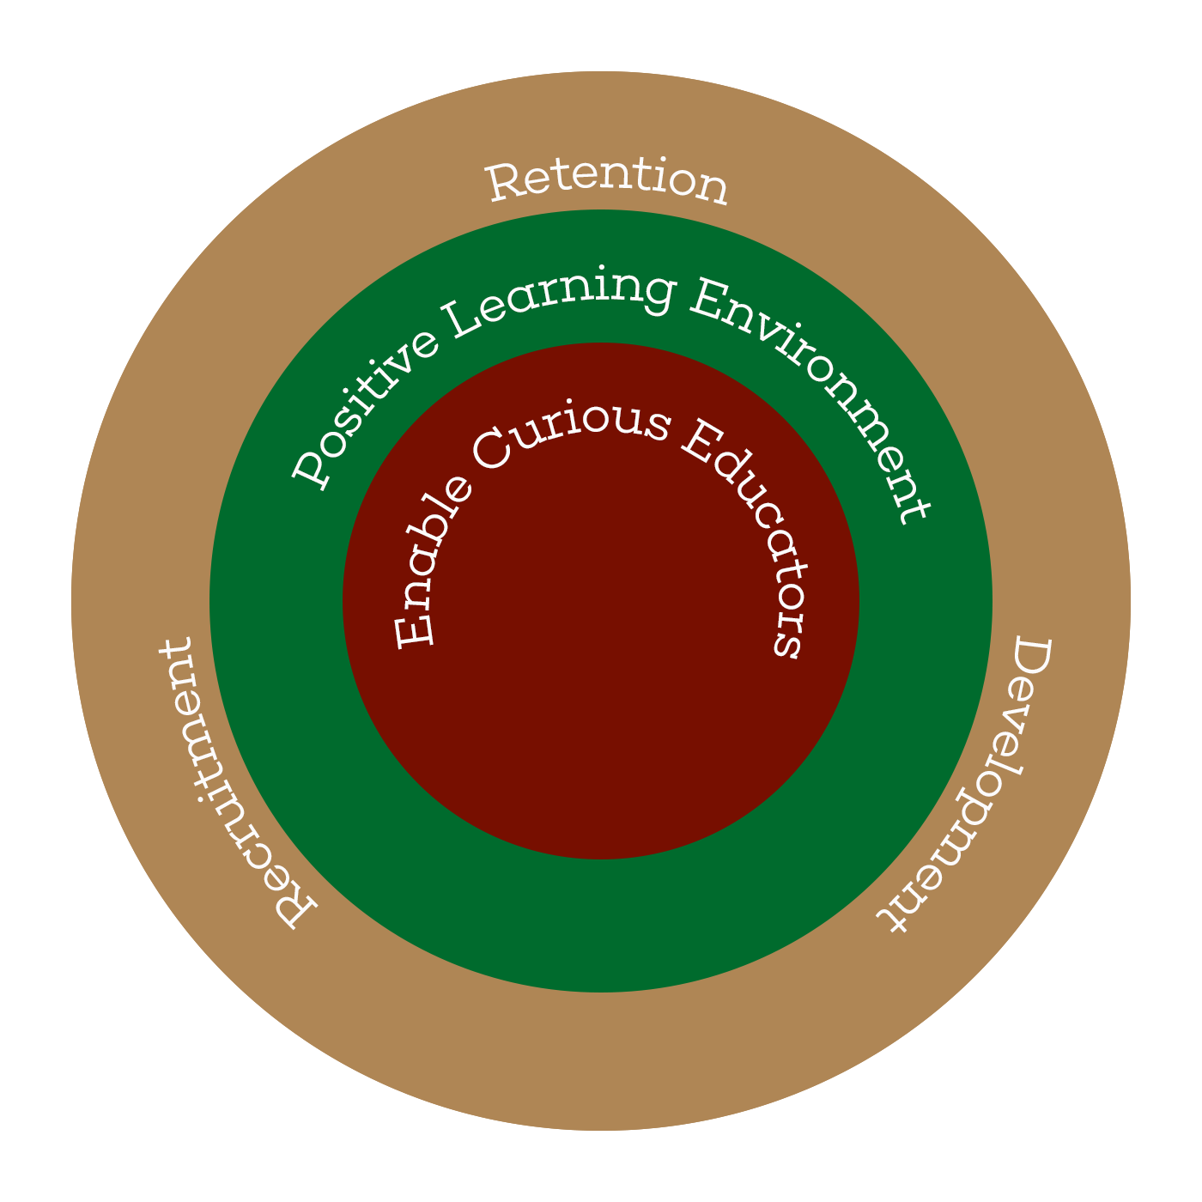
The educator framework
Why:
Enable a Thriving Workforce
The fundamental purpose of WRU Educator programme is to develop people who support the delivery of any of our educational products.
How:
Positive Learning Experiences
This will be achieved through the concepts of Belonging, Discovery and Achievement.
What:
Recruitment, Retention and Development
A modern accessible learning programme comprising of Formal, Informal and Digital platforms.
Notes:
Its important that we establish the Framework, Talk through the why the how and the what

Slide 5
Contextual understanding
CONTEXT IS KING
The context which an educator works within cannot be underestimated and must also be a consideration when meditating volunteer identification, recruitment and development.
Various environments exist within the Welsh Rugby Union landscape. Educators within each of these contexts requires a certain set of principles that are outlined in this document. However, it is important to highlight that each context is very different in terms of challenge and task execution.

Slide 6
Development Decision Making Model
EDUCATOR FRAMEWORK
Craft
Leadership
People
Self Concept
Thriving Learning
Environments
Educator Knowledge
Facilitating Skills
Vision and Inspiration
Persuasion
Problem Solving
Relationships
Collaboration
Emotional Intelligence
Self Aware
Reflective
Continuous Learner
Notes:
The educator framework will be delivered under the following sub sections today you will gain a greater understanding of each but these will also be developed over time and you will receive continuous educator development as part of you’re belonging to the programme.

Slide 7
Development Decision Making Model
Craft
Thriving Learning Environments:
It is an educator's role to continually manipulate the environment to ensure that a candidates learning, and development is optimal especially through facilitation by acquiring strong questioning and listening skills
Educator Knowledge:
Sometimes referred to as the ‘detail’ educators need to be able to clearly articulate and critically evaluate individual and group performance
Facilitating skills
The ability to develop a set of skills and qualities that will provide learners ability to thrive.

Slide 8
Development Decision Making Model
Leadership
Vision:
Educators must form a vision and bring it to life. Vertical alignment is key, and the educator's role is to conceptualise this and create buy in
Inspirational:
Modern educators lead through transformational leadership. They inspire performance by empowering candidates within the environment to share in their own journey as a team
Persuasive:
To create buy in and collaboration it is imperative that educators have strong persuasive skills to ensure that they are constantly managing the environment
Problem Solving:
High performing educators make decisions based on sound judgement, critical thinking and with the intent of reducing the ambiguity

Slide 9
Development Decision Making Model
People
Relationships:
The most effective educators build positive, genuine and authentic relationships with candidates and support staff within their environment with the goal of maintaining a thriving culture
Collaboration:
Educators must collaborate with their management team, proactively involving and utilising others' ideas and areas of expertise and always maintain trust
Emotional Intelligence:
Observing and monitoring a candidate's emotions, motivation and feelings daily is a difficult skill, however being able to perform this as well as understand them is key
ID:
Critically evaluate what is constituted as ‘participation’ and then be able to envisage the fit of a candidate in their personal development

Slide 10
Development Decision Making Model
Self Concept
Self Aware:
Self-awareness is a key component of an emotionally intelligent educator and is critical to effective leadership
Reflective:
Expert practitioners have shown a clear characteristic of knowing their strengths and weaknesses and reflective practice allows an individual to engage with this process on a regular basis
Continuous Learner:
Having an unwavering desire for learning that is inextricably linked to personal development is key to delivery and future growth

Slide 11
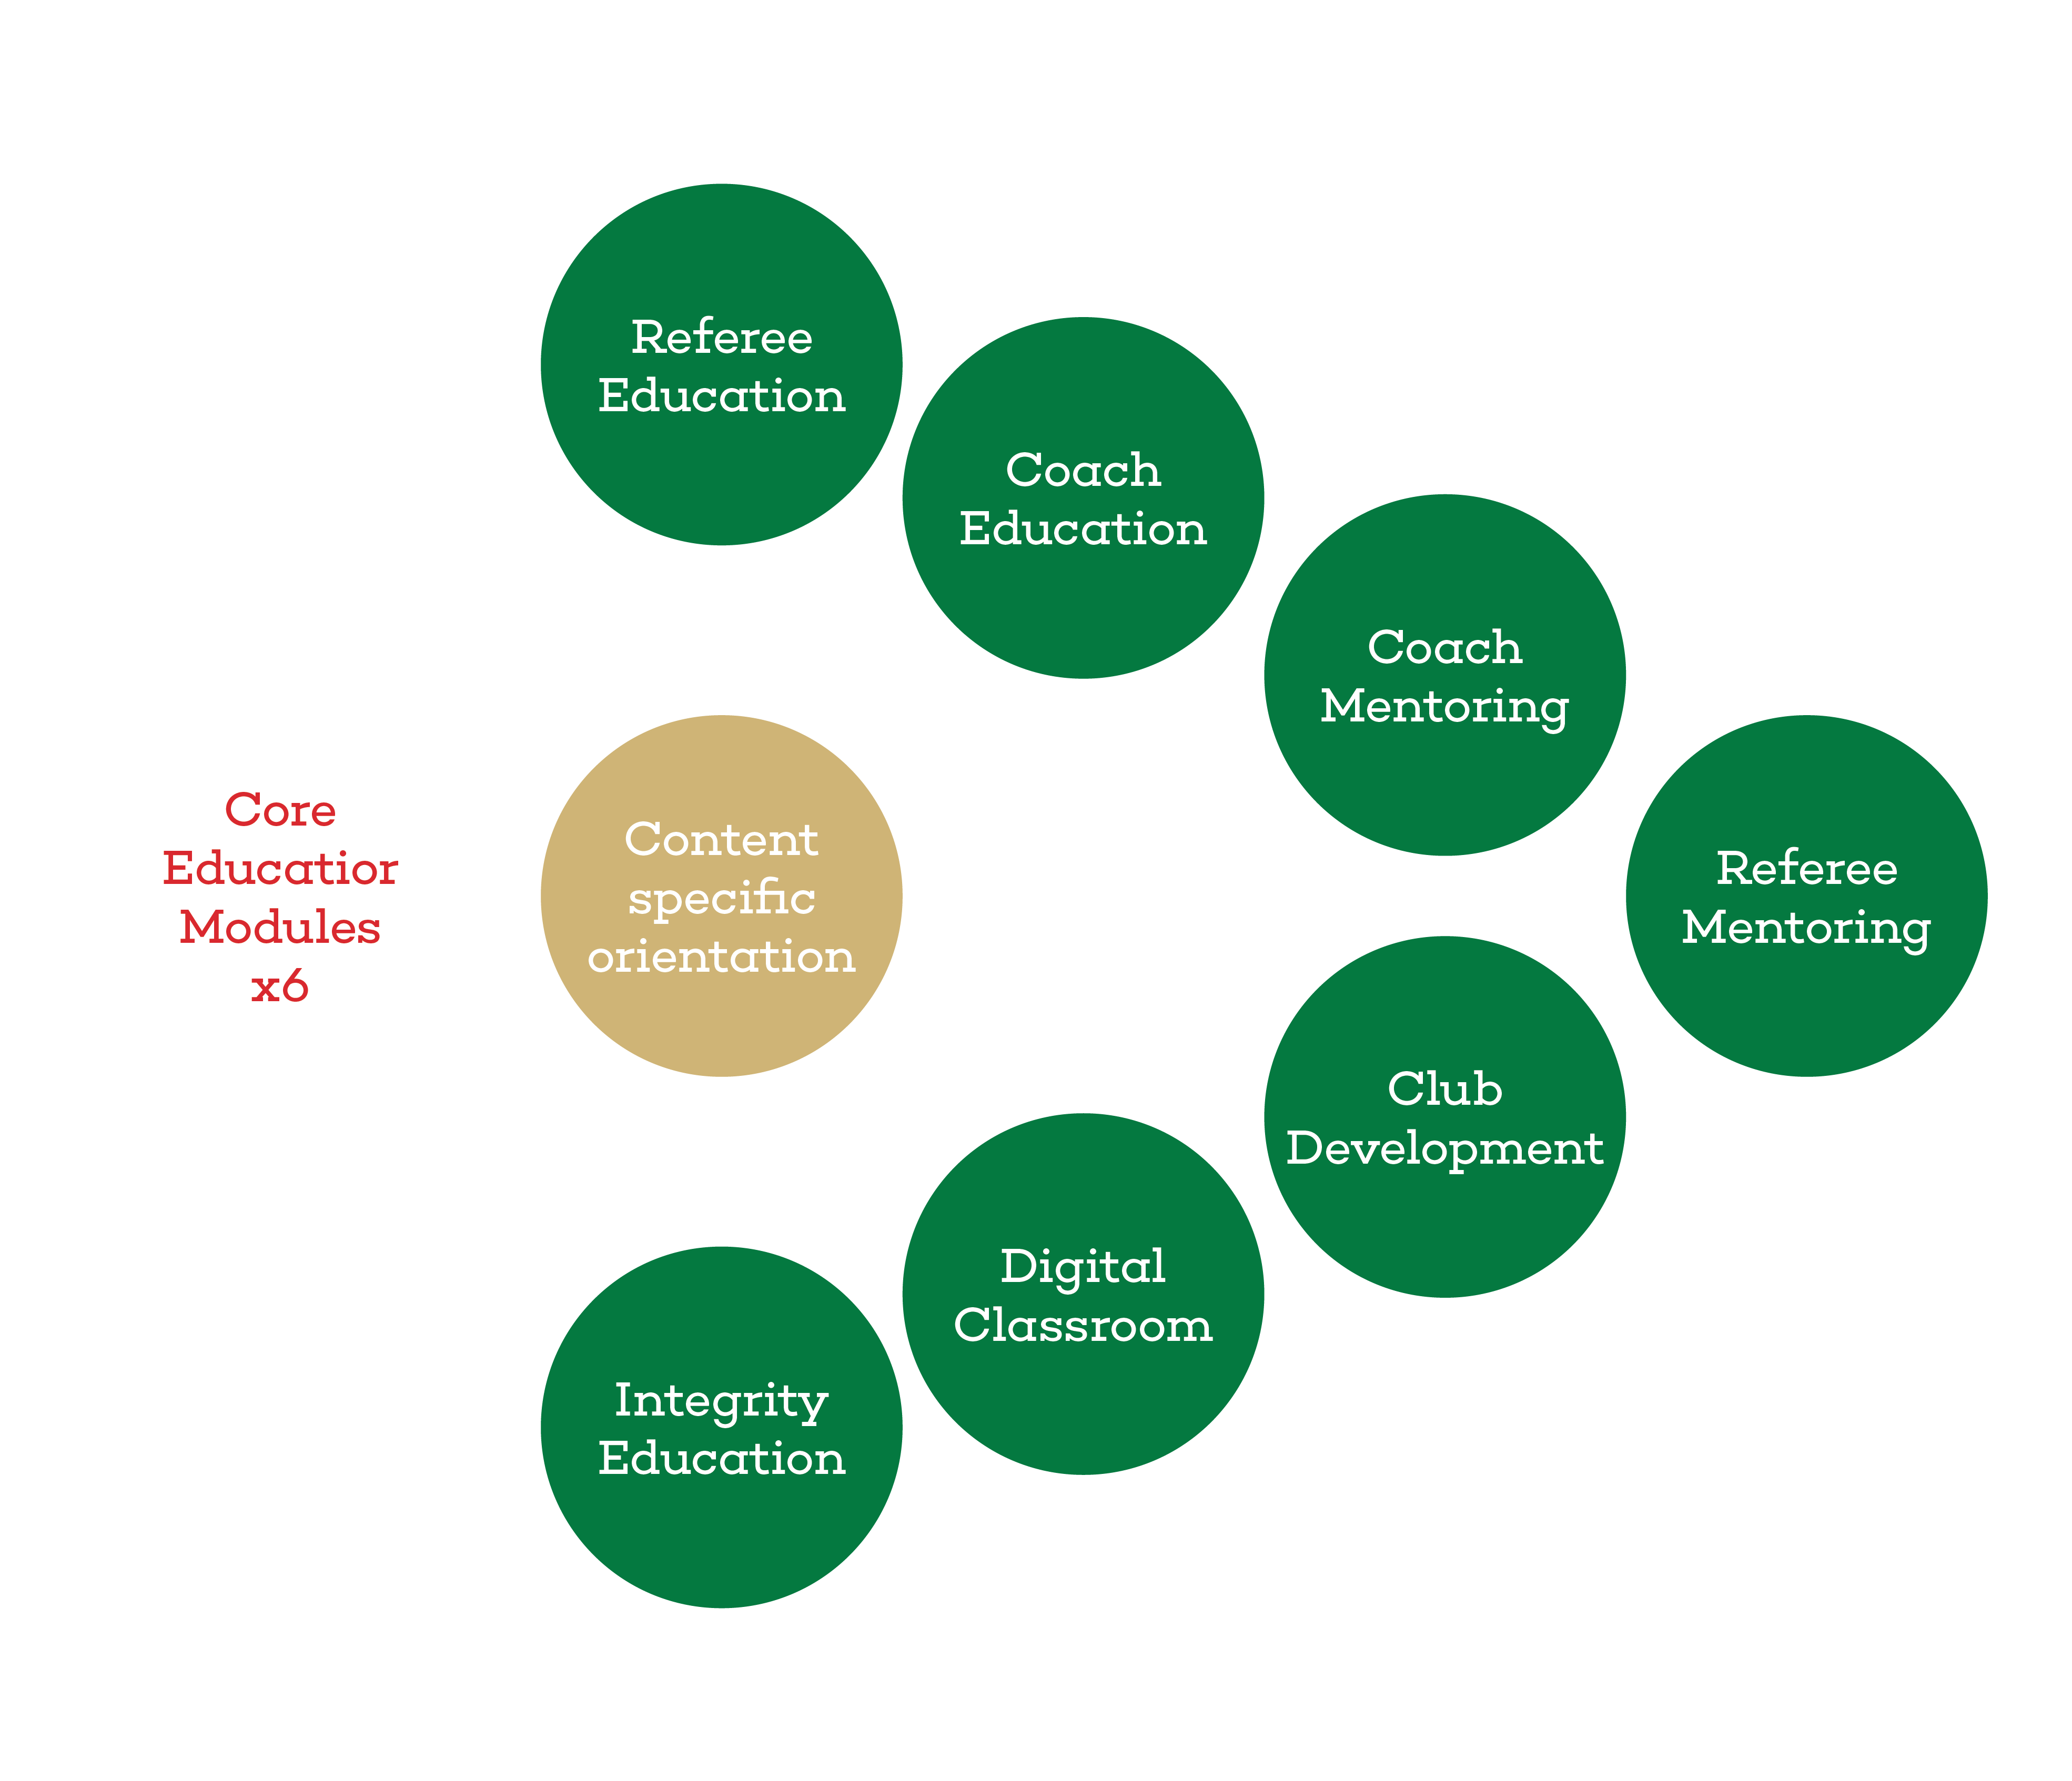
Journey to educating
The journey to educating will be wide and varied the WRU have lots of opportunities for you to express your talents.
Depending on your subject knowledge and experiences there is a potential domain for you.
Everyone will be expected to complete the six core modules of the educator programme.
On completion they will then receive domain specific content training.
The trainer will sign you off as a WRU Educator and deploy you in your specific domain.
You can of course work across many domains.
Notes:
What is the pathway for me?
Explain the diagram and the expectations
If you want give an example of what the domain specific training would be
Coach education – Level 1 coaching
Shadow a course
Complete review module, complete Action planning module
Co delivery with another educator – Both Practically and presenting

Slide 12
Journey to educating
Educator – Is what you’re aspiring to become. You will deliver or assist on formal courses or informal sessions such as CPD.
Leader – You must first be an educator, over time you will be developed to lead formal courses, carry out administrative duties and be part of evidencing educator development.
Trainer – This person is a WRU member of staff who will organise the formal courses, deploy the educators, be responsible for the development opportunities for both the educators and the leaders.
Notes:
Glossary of terms, we will use the terms across all sections of the WRU educating domains its important that we remain clear and concise to aid in the standardization of the programme

Slide 13
Supporting the Journey
Your lifespan as an Educator is a shared journey of learning, you will be expected to maintain your accreditation through attending Continuous Educator Development (CED) events.
You will have a portfolio (PEP) that you will be expected to contribute to and access to the Educator Development Centre on the Game Locker.
WRU EDUCATOR
YOU
This is a paid role, and you will be always expected to uphold
the WRU values and the WRU Educator standards.

Slide 14
Reflect

Slide 15
Reflection
Share your initial thoughts with the person next to you
Is this what you signed up to?
Does this excite you to be part of the programme?
What do you want to know more about?
Notes:
Ask some of your participants to share their thoughts

