Slide 1
Administration

Slide 2
Administration
T’s and C’s
House
keeping
Quality Assurance
Competency

Slide 3
Terms and Conditions

Slide 4
Terms and conditions
On completion of the modules, you will have achieved WRU Educator status this will remain with you for 2 years.
To remain accredited, you must deliver 2 courses a year in your department across the suite of educational courses.
You also must show that you are committed to personal development and participate in Continual Educator Development – This can be via CED opportunities such as workshops, or educator communities of practice.
A record of your delivery and CPD will be kept in your Personal Educator Folder.
You will now enter the next phase of your training which will be department specific, all departments have the same orientation training the only difference is the content you deliver. You will be expected to shadow the course, learn the presentations, and co deliver before your deployment can begin.
On completion of WRU new starter forms you will be able to get renumerated for your services. (Payments on next slide)

Slide 5
Terms and conditions
The sign-off of your training is completed by the WRU Trainer and it is totally their discretion on when this is signed off (Against the WRU Educator competencies)
Most courses are paid on the following basis
Co deliver (Still in training) Hourly rate £15
Educator Hourly rate £20
The WRU trainer who deploys you will fill in your claim form and send on your behalf to the WRU Accounts department to authorize your payment.
*NB Some of the WRU courses are paid at higher rates due to the level of risk associated to the topic and you will be notified of this when its appropriate to you.

Slide 6
House keeping

Slide 7
Standards
When being deployed by a WRU department make sure that you have all the necessary
equipment and information.
Prepare for your delivery by reading the presentation beforehand.
Make sure all videos play on your device.
Wear your WRU kit and be proud to represent the organisation.
Organise the room so its conducive for learning and is dressed with WRU branding.
Complete any administration duties required by the deploying department.
Use social media when appropriate and follow the WRU guidelines

Slide 8
Quality Assurance

Slide 9
Quality assurance
Quality assurance takes place in any training establishment to ensure the products and services are the best they can be.
The product is the programme or qualification that the learner is working towards.
The service is everything which underpins the product and supports the learner.
If quality assurance does not take place, there are risks to the accuracy, consistency and fairness of training and assessment practice, which might disadvantage learners.
Quality assurance is a continual process with the aim of maintaining and improving the products and services offered.

Slide 10
The Reasons why?
We have lots of different types of products and services that we deliver from courses with qualifications attached to Continuous Personal Development sessions that are informal in design.
For us at the WRU quality assurance is a tool for development and standardisation not a surveillance or stick beating exercise.
There will be a plan on what will be monitored by whom and when. This will lead to developmental feedback and opportunities develop your skills and share your experiences.

Slide 11
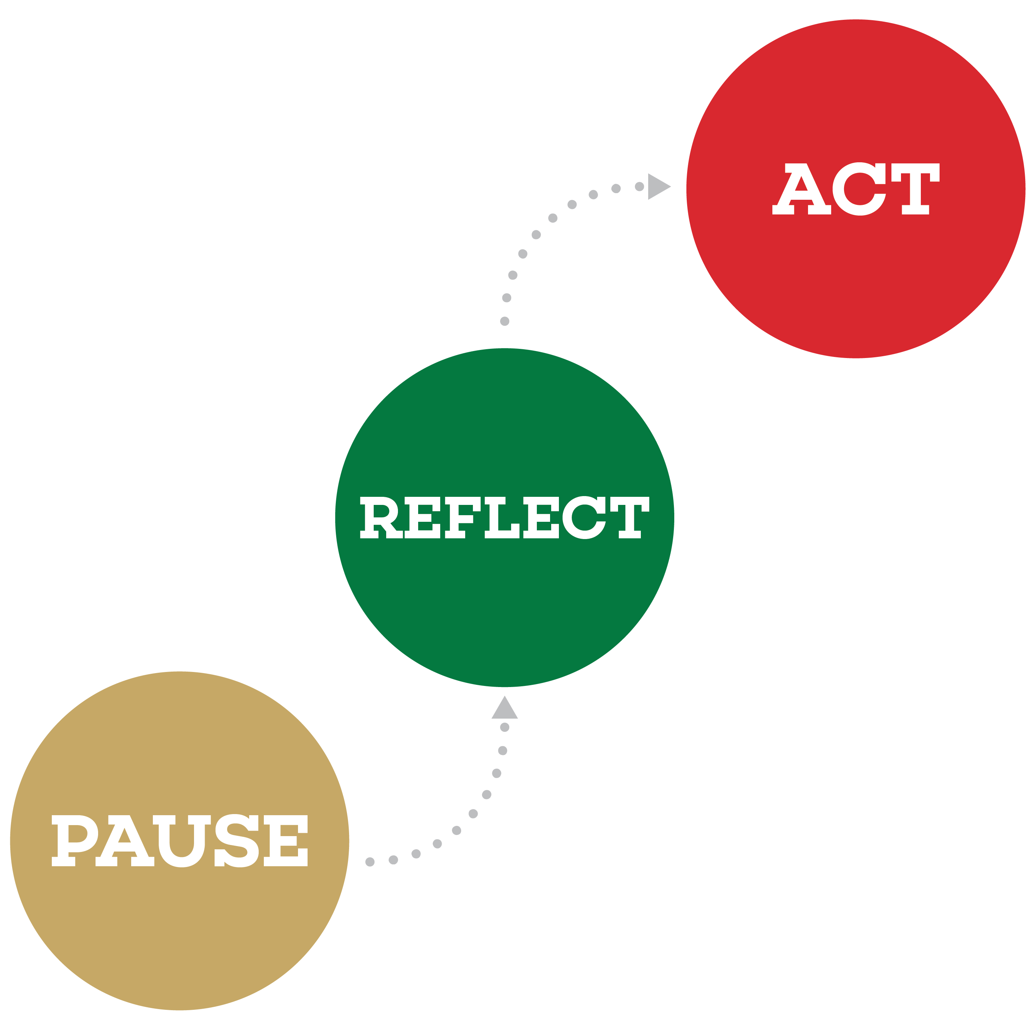
Process
YOU WILL RECEIVE:-
2 Delivery Observations a year by your trainer.
2 Peer Observations a year.
You will be expected to complete 2 self reflections a year.
All this will be collated and stored in a central folder structure that you and the department deploying you will have access to.

Slide 12
Competency

Slide 13
Competencies What are they? why do we use them?
Competencies are cluster of highly interrelated attributes, including knowledge, skills, and abilities that give rise to the behaviours needed to perform a given role effectively.
At the WRU they help us:-
Communicate the purpose
Identify key themes
Get conditions right
Tackle the root cause
Keep it simple
Train, don’t blame
Notes:
Communicate the purpose – Find out if employees understand what the framework’s purpose is. If they don’t understand how behaviours contribute to personal and organisational success, there’s little point in updating or developing the framework.
Identify key themes – Even if staff are clear about the framework’s purpose, it must also support the organisation’s aspirations (goals, values, business plans, and so on). If people aren’t all working towards these, some individual efforts are likely to be diversions.
Get conditions right – The organisation’s procedures need to support the framework, and the culture, resourcing and management structures must be supportive too. Be realistic: if conditions inhibit behaviours, then change the conditions or change the behaviours.
Tackle the root cause – As well as goals and conditions, behaviour is also influenced by underpinning characteristics (knowledge, skills and attitude). One underdeveloped characteristic, such as communication skills, can affect many different behaviours. If managers don’t understand this distinction, they may focus on trying to improve the behaviour without tackling the root cause.
Keep it simple – There are two key elements to ease of use – language and structure. However, ‘perfect’ the framework, if it’s too complicated, long or detailed it won’t be used. The language must be meaningful to the people who use it.
Train, don’t blame – Once the structure has been updated, make sure that everyone who uses it is trained. As with any tool, if users don’t know how to use it, it will fall into disuse or fail to meet its full potential.

Slide 14
Delivery Competencies
Keep it relevant
Draw on experience of group
Emphasise the importance
Keep conversations focus on the subject
Why will the subject help them
Ask for examples on the subject
Respect the information given
Question the experiences
Foster Collaboration
Give them time to discuss with others
All and encourage cross conversations
Share conversations
Encourage Participation
Provide Feedback
Use open ended questions
Build Rapport with the group
Listen to what they have to say and acknowledge their answers
Give the learners feedback
Use positive affirmation
Provide positive challenge and encourage them to find alternative answers

Slide 15
Next Steps
Speak to the Coach and Referee Development officer and Integrity Officer to see what opportunities are available to you
Opportunities

Slide 16
Next Steps
Shadow the course that you feel is right for you and observe how its delivered
Opportunities

Slide 17
Next Steps
Upskill yourself by studying the presentations and tutor notes
Opportunities

Slide 18
Next Steps
Co deliver with another educator and get signed off by your trainer
Opportunities

Slide 19
Congratulations!

