Slide 1
Leadership

Slide 2
Transformational leadership
Success isn’t just about what you accomplish in your life, its about what you inspire other to do

Slide 3
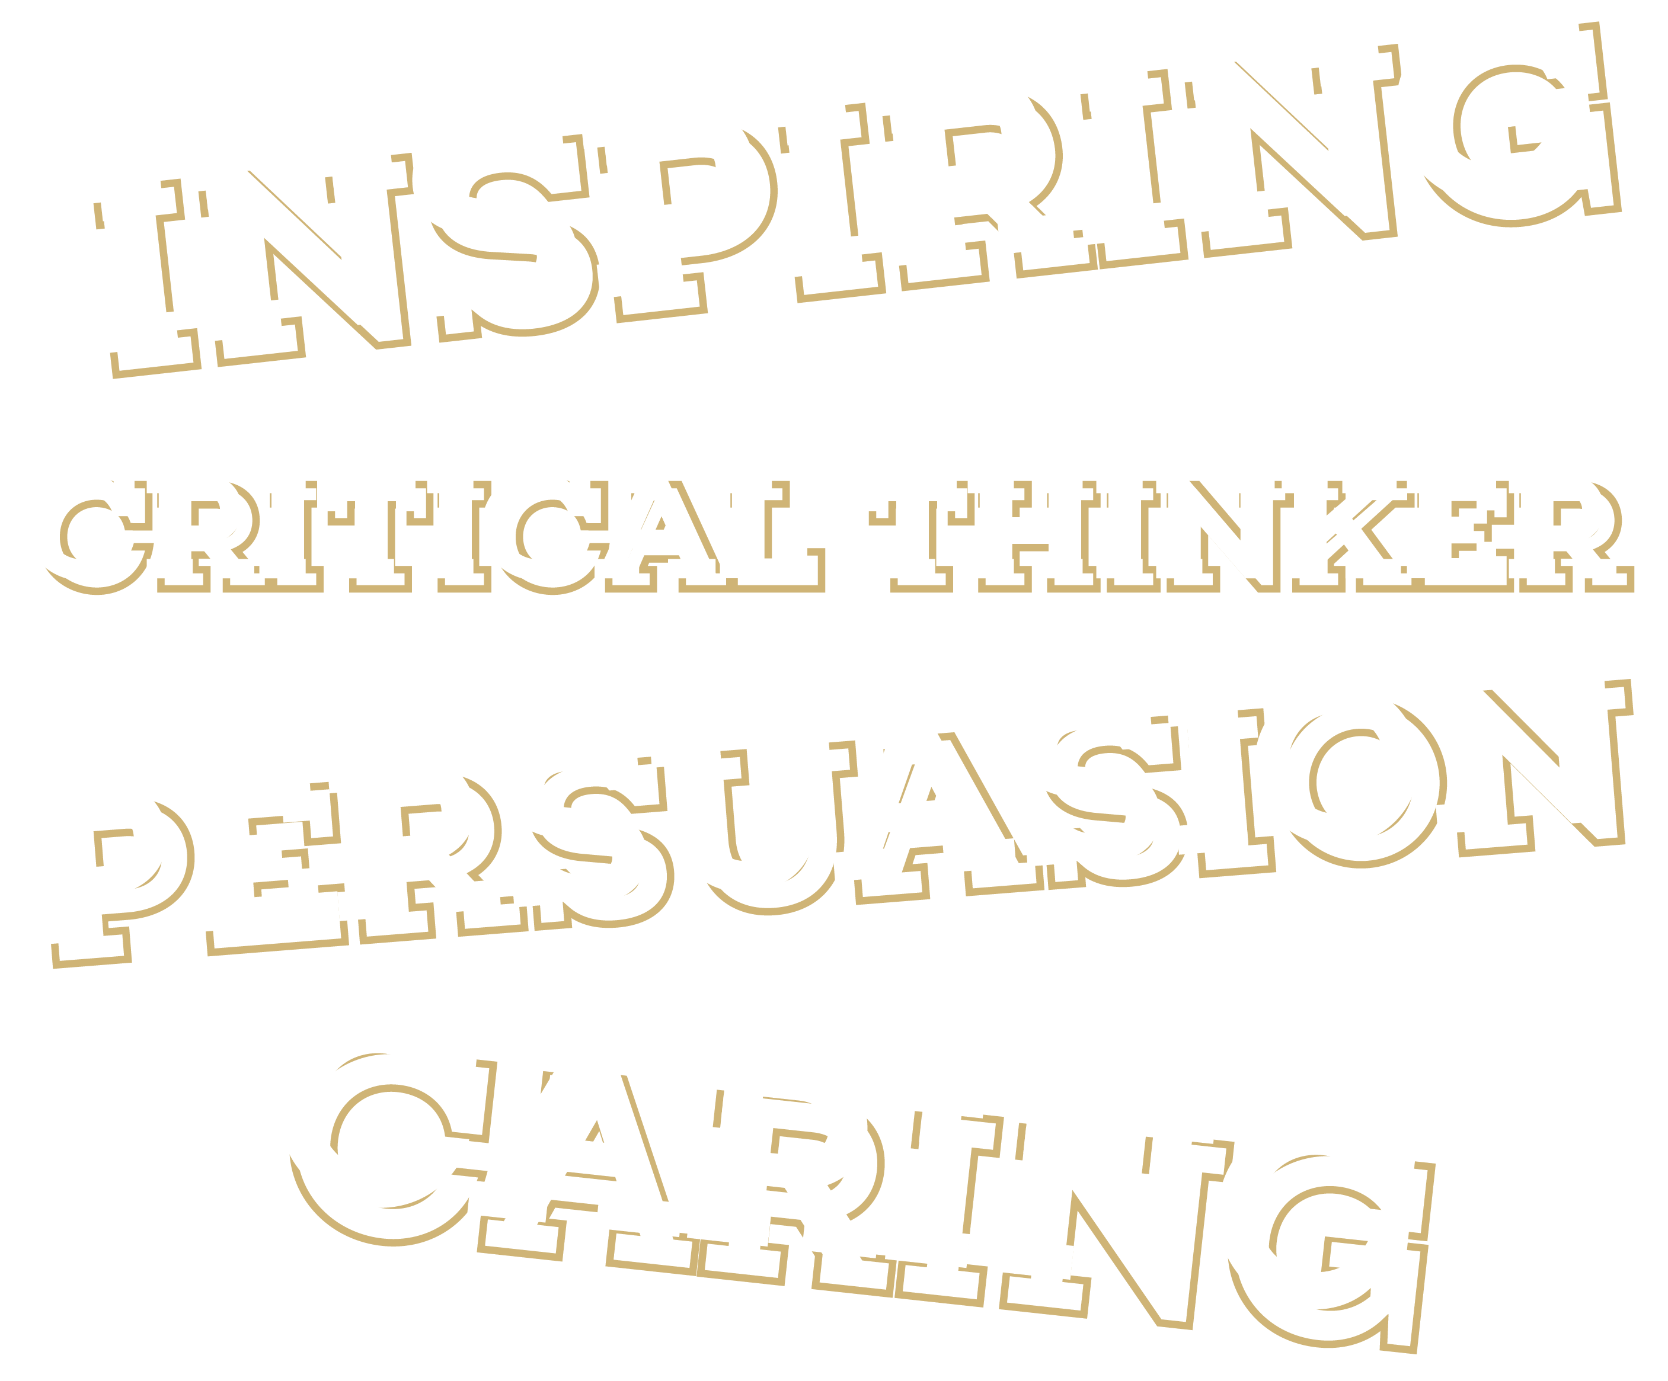
What is transformational leadership?
Transformational leadership is a style whereby educators influence, inspire, critically think and encourage candidates to deliver positive change.
Notes:
We are going to take each heading and have a look at how this effects your role as an educator

Slide 4
Vision and Inspiration
“If you are working on something exciting that you really care about. You don’t have to be pushed the vision pulls you”

Slide 5
What is vision?
Vision is a mental picture of the future. Vision is the thing inside of us that guides us. It creates a desire to grow and improve. Vision embodies our hopes and ideals. It gives us a sense of purpose. Visions brings us flashes or glimpses of what is possible.
Vision is an expression of what the organisation wants to become and be known for.
Discuss in groups and produce an example of a company that has a great vision and lives its values?
Notes:
Get the group to shout out some answers and ask them

Slide 6
Example
Vision statement: To be Earth’s most customer-centric company; to build a place where people can come to find and discover anything they might want to buy online.
This statement communicates that Amazon wants to provide customers with anything they might want. Its aim is to build the company to be so expansive that any Amazon customer will never need to shop anywhere else again.
Notes:
Did you know in the the Amazon sign that the arrow is representing A to Z

Slide 7
Video of the WRU strategy – this is rugby
Notes:
Make sure that the volume is up high to get maximum effect !!!

Slide 8
WRU Educator Vision
This is our WRU Educator vision
The WRU will ‘Enable a Thriving Educator Workforce’ by providing ‘Positive Learning Environments’ through the ‘Educator Framework’ to ensure successful
‘Recruitment, Retention and Development’.
In groups discuss what should your vision be as a group of educators?

Slide 9
Critical thinker
“By allowing yourself to consider
different perspectives you might
find yourself hitting upon solutions
you hadn't previously considered.”

Slide 10
What is Critical thinking?
Watch the video, on completion discuss with the person next to you the components of critical thinking.
In your role as an educator why is it important for you to be a critical thinker?
How do you get those that you're educating to become critical thinkers?
https://www.youtube.com/watch?v=HnJ1bqXUnIM
Notes:
Facilitate the answers

Slide 11
How to improve your critical thinking skills
Use scrutiny and scepticism
1
Eliminate the less useful and unreliable information
2
Use reliable sources
3
Listen Actively
4
Use empathy
5
Notes:
How to improve critical thinking skills
The steps above seem simple enough, yet with the various obstacles and emotions involved in decision making, it can sometimes be hard to let your head rule above your heart. So how can you improve your critical thinking skills?
There are several ways that you can achieve the benefits of critical thinking, including:
Use scrutiny and scepticism
It requires little effort to accept things at face value and believe what you’re being told. However, doing so is not particularly helpful for critical thinking. Instead, you should question what’s in front of you, ask what the motivations are, and how accurate the information is.
Eliminate the less useful and unreliable information
It can be difficult to make effective decisions or draw informed conclusions when you’re surrounded by inaccurate information. Using your critical eye and scepticism, you can start to discount the bad arguments and biased claims.
Use reliable sources
When you’re researching a topic to make an informed decision, always pay attention to the source. Look at evidence-based information from reliable outlets and be careful of how statistics are presented to you. Try and explore past the surface-level claims of studies to find out what they’re actually telling you, and whether there is enough of a sample size to make a conclusion.
Listen actively
Active listening is a technique that ensures the listener concentrates, understands, responds to, and remembers what’s being said. It’s also about observing behaviour and body language. This type of active listening can help you fully understand what’s being said and why, and what the pros and cons of the argument are.
Use empathy
Being able to put yourself in the shoes of another person allows you to understand their point of view, motivations, and aspirations. In doing so, you’re better able to appreciate why they hold a particular belief or think in a certain way.

Slide 12
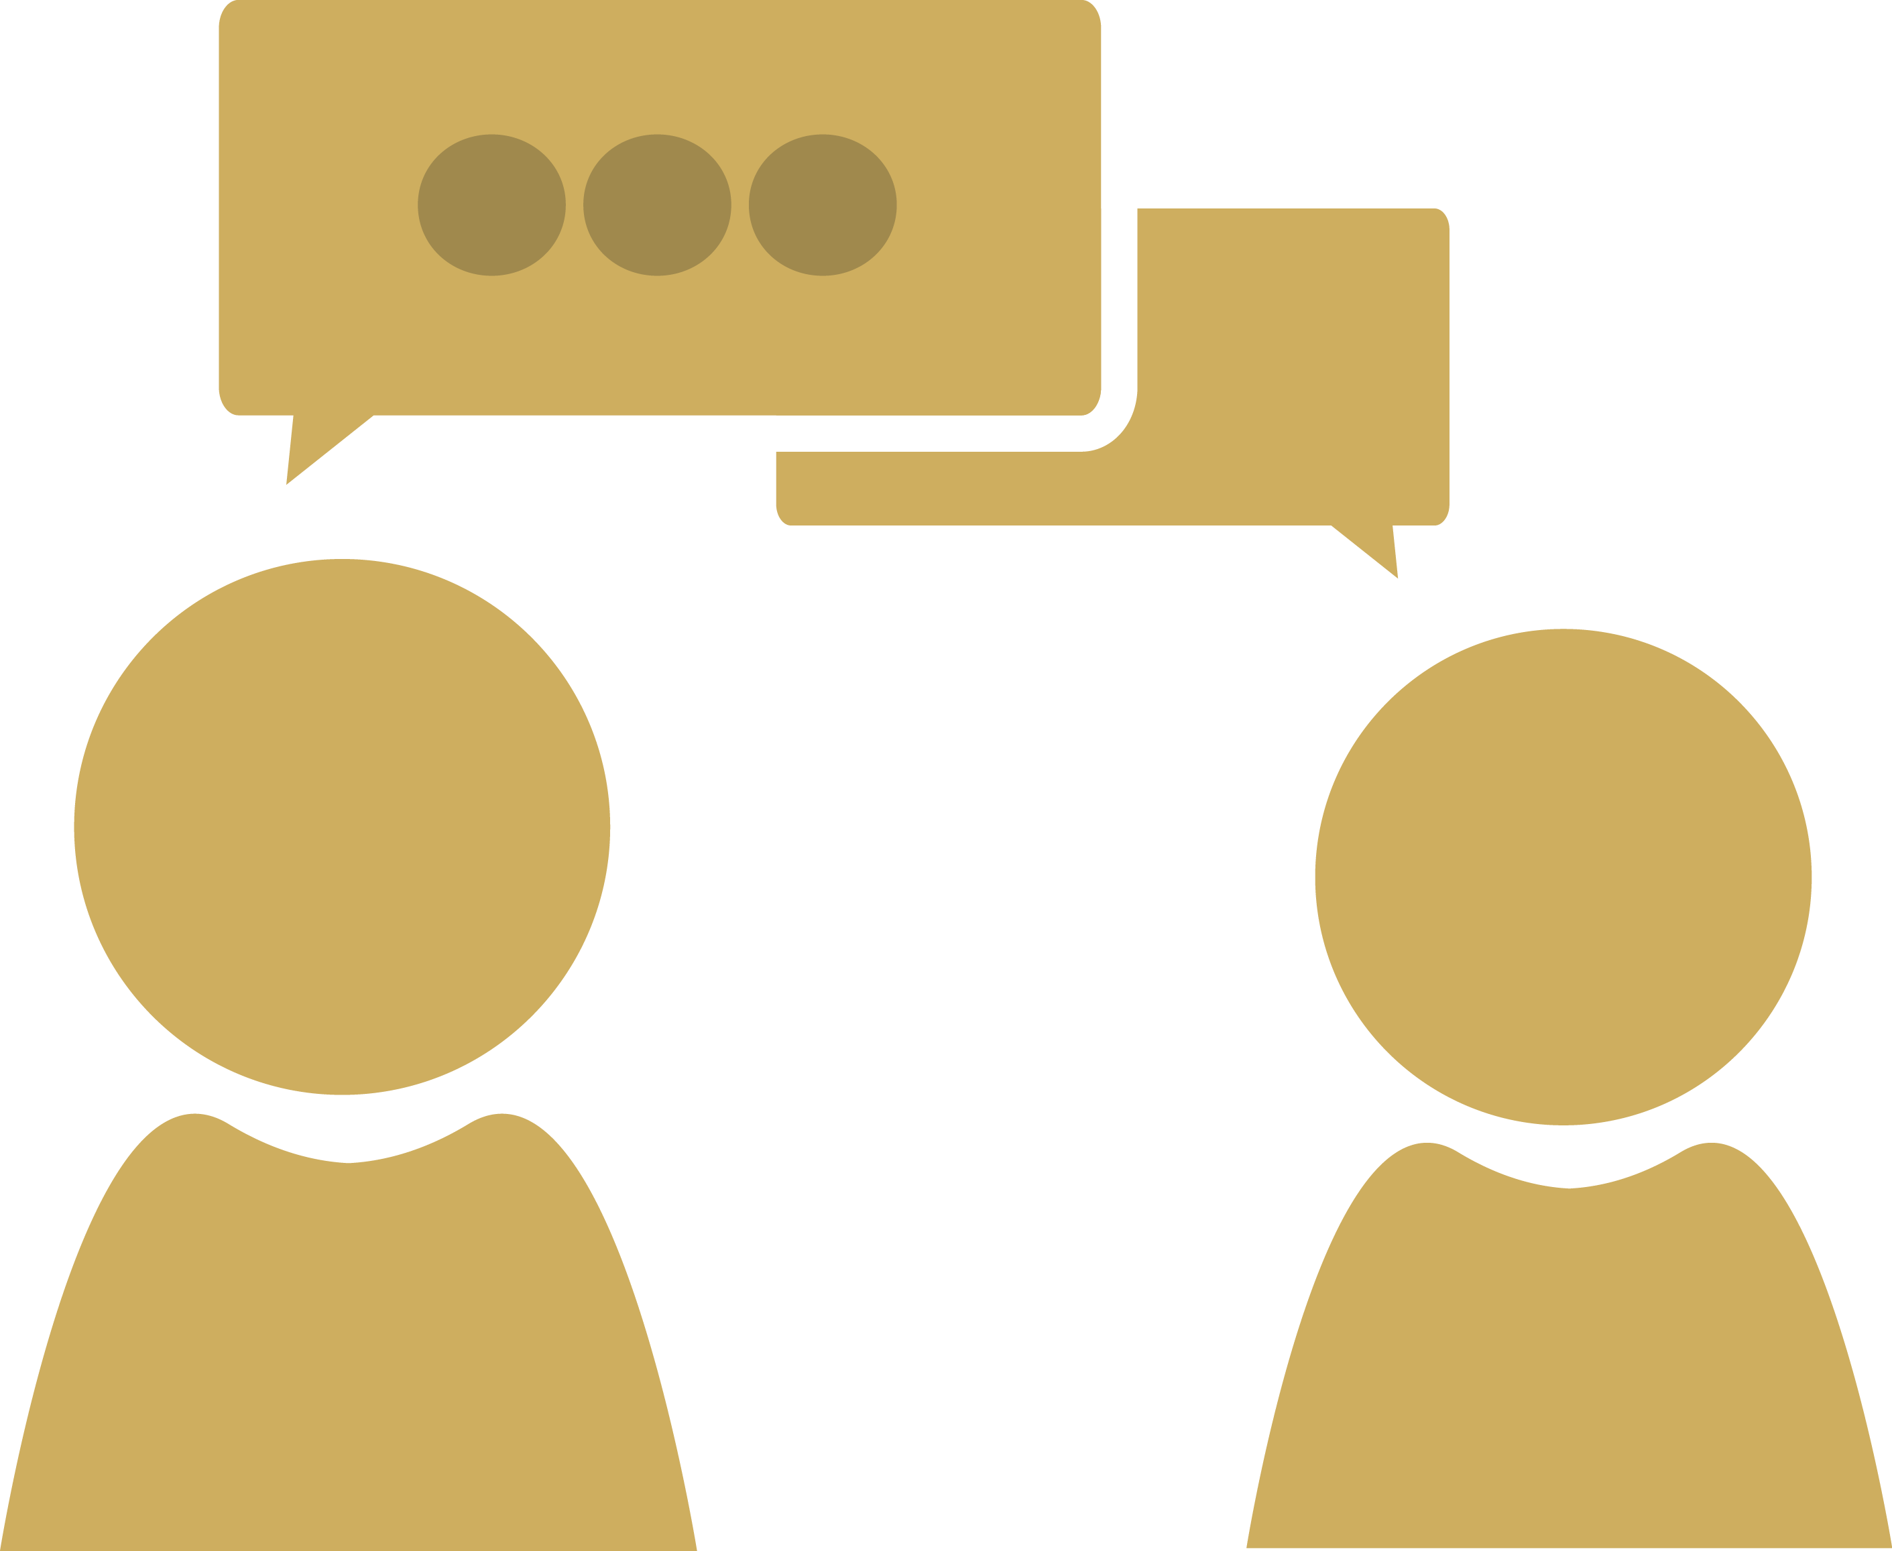
Our Goal!
Those who find solutions
Well-informed individuals who looks at old problems in new ways
Educators and Candidates
Those create lots of ideas
Those who challenge boundaries
Those who apply a range of disciplines
Those who promote creativity

Slide 13
Persuasive
“Persuasion is not a science but an art.“

Slide 14
Persuasion
Persuasion skills refer to the skill of changing or influencing the behaviours, beliefs or attitudes of someone or a group towards another idea, person or event.
In your groups discuss what are key attributes to someone being a successful at persuasion?
Honest
Knowing their subject
Building rapport
Being entertaining
Not arguing
Genuine
Sincere
Notes:
Use the answers to help you guide your candidates

Slide 15
Task
With your partner label yourself A and B
A use your persuasive skills to convince B one of the following scenarios:-
Riding your bike to work is better than driving
Salad for lunch is better than Sandwiches
Games are better for coaching than drills
Macron is more comfortable than Under Armour
On completion what techniques did A use to persuade you.

Slide 16
Persuasion Techniques
The Framing Method
Talk About We not You
Be Specific and Confident
Explain what's in it for them
Create scarcity and urgency
The but you are free technique
It's working for others approach
The Yes ladder
Use evidence and data
Notes:
1. The ‘framing’ method
Carefully describing or explaining something in such a way that influences how the recipient interprets the information being given is known as ‘framing’. Take the classic example of a glass that is ‘half full’ or ‘half empty’ – the first phrase sounds much more positive, even though the same object is being described in both instances.
This technique is often used effectively by politicians when debating their opponents, to influence the audience to agree with their point of view.
Framing has three core elements:
Placement – choosing the right time, place and people to communicate with
Approach – carefully constructing how your argument is presented. People are more likely to respond better if you explain the positives of your viewpoint, rather than any potential downsides
Words – selecting the most appropriate words to explain your viewpoint
2. Talk about ‘we’, not ‘you’
By using the word ‘we’ instead of ‘you’, you’re saying that your opinion or strategy is relevant to the whole team, rather than just to your vested interests. Being part of a team decision or project is far more appealing than being left out.
3. Be specific and confident
If you speak confidently, clearly and concisely, people are more likely to listen to you, to take what you have to say seriously, and to agree with you. Prepare what you want to say; make sure you have everything clear in your own mind before tackling a tricky conversation. When speaking, avoid filler words – such as ‘umm’, ‘err’ or ‘like’ – because these suggest that you’re struggling to express your message or are uncertain about its validity.
4. Explain what’s in it for them
One great way of persuading people is to explain the benefits that will affect them specifically. If someone can see and appreciate that agreeing with you will offer advantages to them personally, they’ll be much more inclined to agree with you.
5. Create scarcity and urgency
Creating a real need for something, or a time constraint, makes people want something more than if it were abundantly available. Think about the limited-edition products that brands launch – the fact that consumers believe they may miss the opportunity to own something new makes them rush out to buy them.
6. The ‘but you are free’ technique
A 2013 review of 43 research studies, which involved 22,000 participants, found the ‘but you are free’ (BYAF) technique to double the chances that someone would say ‘yes’ to a request. And it’s a devastatingly easy strategy to put into action: simply remind the people you’re talking to that they are free to make a decision on the subject you’re discussing, and they will be more disposed to agree with you.
7. The ‘it’s working for others’ approach
People naturally look to others to make their decisions and influence their behaviour. For example, if a crowd of people are looking up at something then we’ll automatically do the same, and continue to look even if there’s nothing there, because we believe there must be something if others are looking. This ‘herd effect’ can be used to persuade, too: pointing out that a particular service or strategy is being used by a lot of people in your industry or profession can seal the deal.
8. Get agreement on a more minor point first
In a sales environment, this is known as the ‘yes ladder’ – by getting someone to agree with a minor point, or to carry out a smaller task, you will be more likely to get them to agree with a bigger project.
9. Use data and evidence to support your cause
If you have evidence and data that supports your idea – whether that’s from academic studies, surveys you’ve spotted in the press, examples of good industry practice, or research that you’ve undertaken within your organisation – your proposal will carry more weight. If you’re hoping to introduce a new initiative, running a pilot scheme to generate real-world results is a useful first step; your HR software‘s reporting functionality should help you analyse the impact of projects such as a new training course, or changes to employee benefits, on key HR metrics such as retention, engagement and job performance.
10. Pay attention to your body language
Your body language also has a significant impact on your ability to persuade:
Smiling naturally – makes you seem approachable and likeable
Raising your eyebrows – signals you are not a threat, and are friendly and approachable
Avoid crossing your arms and putting your hands in your pockets – signals that you don’t feel comfortable and makes you appear less approachable
A visible neck – shows that you are unthreatening and easy to approach
Eye contact – shows interest in the conversation and trustworthiness
Wear colour – complimentary colours make people stand out and seem more attractive
Show your palms – indicates you are telling the full story

Slide 17
Caring
“Sometimes it takes only one act of kindness and caring to changes a person's behaviour”

Slide 18
The importance of caring
Caring is the extent to which an educator attends to each candidates needs and is a guide to them.
The educator listens to the concerns and needs and provides support and is empathic of each person’ situation and background.
When an educator shows they care they also show they are aware of the unique talents that each candidate can bring to the situation and support them in developing and demonstrating these key skills and behaviours..

Slide 19
Why?
While investing time to those on a course may seem a fruitless exercise as you only engage with them for a short period of time, don’t underestimate the lasting effect that you can have on them and the potential you can have to influence positive change in their behaviour.
What are the three things that you are going to do to give the people attending your course the best experience?

Slide 20
Educators/Transformational leaders
1
2
3
4
5
Are Visionaries
Attend to each persons needs.
Empower their followers to perform beyond normal expectations
Are excellent role models
Use intellectual stimulation to motivate followers to think outside the box

Slide 21
Reflect

Slide 22
Reflect
Share your thoughts with the person next to you
What did you enjoy about the module?
What do you want to know more about?

