Slide 1

TAG RUGBY
U7 & U8

Slide 2
Introduction
Introduce self
Health and Safety of venue
Health and Safety for Candidates
Learning Outcomes
Understand and manage a playing area
Understand how to manage a group
Warm ups can be and should be fun

Slide 3
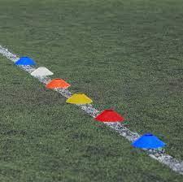
Working Area
Split the group in half and ask the groups to set a playing area for a game of keep ball 5v5 – see what they come up with?
Coach educator to set up paying area for the first warm up 424 grid with nest.
What else goes in the nest?
Check the participants for watches, jewelry, ear rings etc
Notes:
T1. Promote discussion on the size of the grids.
Why would it be more beneficial to have bigger or smaller grids
Could we use same color cones for different playing areas
5 meter spacing
T2. Opportunity to check for understanding on playing area safety
Is the are set up safe - Away from posts or walls, dog mess, sharp objects
Players - Fit to take part, appropriate clothing, jewellery
First aid - have we got a first aid kit, first aider, accident book
T3. Is this a good warm up WHY? Refer back to APES
.

Slide 4

Warm UP
Play a game of huggy bears why? Groupings Etc
Play a game of keep ball
Split the groups – get them to make a warm up
Fun Fun Fun
Notes:
T1. Why was this be a good game -, Active, purposeful, enjoyable and safe
Good way of getting a large groups into smaller groups
T2. Why is this a good warm up?
What are the negatives of this warm up? Not every player has a touch if they are a week player.
T3. Why is this version better?
As a leader/coach am I able to watch both games?
APES
T4. Coaches given the first opportunity to deliver, Coach educator to feed back to the candidates
Who could we get ideas off to adapt the activity?
KEY POINTS
Quick to set up
Few rules
Challenging

Slide 5
Playing The Game
Learning Outcomes
Experience playing the game of tag
Develop an awareness of the tag rules.
Before you start to play – go through how to put the belt on and all the cheats
Play
Split the group into two teams of no more than 5v5 (walking Tag If needed), introduce 3 rules
Run forward pass back
Wear 2 tags at all times
Tag- Pass- Tag (give tag back)
Notes:
Keep playing the games and introduce all the rules with stoppages in the game
Tag Rules
Run forward pass back
o Wearing two tags at all times
o Tag – Pass – Tag (Give tag back)
o 3 x 3 (3 steps and 3 seconds)
o 1m offside from tag – free play
o 5m offside from free pass – play on referee
o 6 tag turn over
o No handoffs
Free pass infringements
Offside
Receiving ball with only one tag Knock on
Ball in touch
No tags left
Physical contact i.e. hand-off
3 seconds expires before passing

Slide 6

Skill Identification
Learning outcomes
Identify core skills of Tag rugby
Develop an understanding of how to introduce the core skills to players using the APES philosophy
3 Core Skills of Tag rugby
Evasion
Tagging
Handling
Notes:
T1. What are the 3 core skills that they identify from playing the previous game.

Slide 7

Handling
Learning Outcomes
Coach manipulate activities to put the players under pressure
Coach educator to set up a game of end ball
Coach educator to ask candidates for constraints we could pit on the game to affect learning outcomes.
Coaches to set up activities concentrating on catch pass
Notes:
T1. Play a game of endball with emphasis on catch pass.
T2. Adding constraints
No ball on chest (ensures ball in 2 hands)
Number of passes to score
Change scoring zones
Overload
T3. Coaches to give opportunity to set up catch pass activity. Coach educator to micro review and feedback.

Slide 8
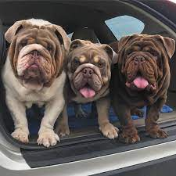
Evasion
Learning Outcomes
Coach can set up activities with the emphasis on evasion and manipulation of space
Coach educator ask the question what is evasion?
Coach educator to set up a game of Bull dogs.
Split the group up into 3’s and give them 5 minutes to come up with an adaption to the game.
What other games are there apart from bulldogs
Notes:
T1. What is evasion? Dodging, sidestepping, changing direction
T2. After playing the game coach educator to Question the group on what the did to avoid contact. Did the activity fit into APES
T3. How can we ensure that less mobile players have success?
When less mobile players are tagging
When less mobile players are evading
T4. Coach educator to demonstrate Bonus Tag Bulldogs

Slide 9
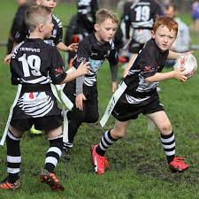
Tagging
Learning Outcomes
Coach has an awareness of rules of play surrounding tagging
Coach educator to set up a game of last man standing
Coach educator to challenge candidates to come up with their own activity highlighting tagging
Notes:
T1. Set up fox and hounds game, emphasis on boundary rules and returning the tags as is pathway rules.
T2 Candidates given 5 minute to come up a variation on a new game concentrating on tagging. Activity must adopt the principle of APES
Coach educator to give feedback ( micro review)

Slide 10
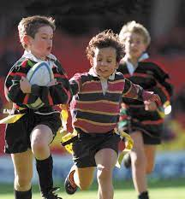
Officiating the Game
Learning Outcome
Develop experience of refereeing the Tag game
Develop an understanding of applying the rules of play to Tag rugby
Coach educator to set up a game of TAG rugby. 1 candidate will referee while 2 candidates will coach the rest of the players from behind.
Invite group feedback on the performance of the referee
Notes:
T1. Set up a tag game 3v3 walking
Question the players on the core rules of the game and referee a game for 3 minutes asking the coaches to observe you and comment on your performance
Demonstrate clearly the following traits and facilitate feedback:
Use of the whistle – commanding presence o
Explain decisions – create a positive learning environment for players
Knowledgeable – Know the rules
Decisive – Make a decision and stick by it
Communicate clearly with players during open play - # Tags etc.
T2. Feedback from players on each referee – 1 positive and 1 work on

Slide 11
Resource
Notes:
T1. Set up a tag game 3v3 walking
Question the players on the core rules of the game and referee a game for 3 minutes asking the coaches to observe you and comment on your performance
Demonstrate clearly the following traits and facilitate feedback:
Use of the whistle – commanding presence o
Explain decisions – create a positive learning environment for players
Knowledgeable – Know the rules
Decisive – Make a decision and stick by it
Communicate clearly with players during open play - # Tags etc.
T2. Feedback from players on each referee – 1 positive and 1 work on

