Slide 1
Rugby Leaders2 A guide to delivering

Slide 2
The Rugby Leaders 2 Course
The Rugby Leaders 2 course is an extension of the rugby leaders course
It’s been designed to be modularly delivered – And must have the learners pace at the forefront
There are lots of opportunities for coaches to be assessed and supported through the course
It is designed for those who coach Under 9 to Under 12
It has 6 modules
There is no formal assessment but ongoing competencies that have to be checked off before moving onto the next module
The practical elements are based on the U9-U12 WRU Pathway, Tackle, Contact area and scrum
There is a big emphasis on coaching skills through games

Slide 3
Course Learning Outcomes
By the end of the course learners will be able to:
Provide a safe and fun environment to learn.
Have the ability to coach and understand the benefits of coaching through games.
Understand the benefits of ‘Whole Player, Whole Coach
Effectively and safely coach the tackle, contact area and the scrum
Understand the WRU Development Pathway and age laws

Slide 4
Programme
Pre-course:-
World Rugby “Rugby Ready” online programme
( download certificate and show on course )
World Rugby Concussion online workshop
( download certificate and show on course )
World Rugby Introduction to contact online course
( download certificate and show on course )
On course:-
Session plan and delivery of decision make and Games
Delivery of the tackle
Delivery of the contact area
Delivery of the Scum
Volunteering hours 5 coaching, 5 referering

Slide 5
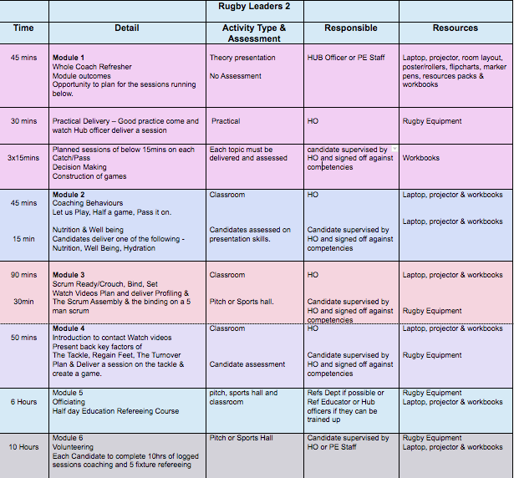
Timetable

Slide 6
Theory Modules
Designed to be as interactive as possible, moving away from the deliverer standing out the front and preaching
Presenter is there to set the scene and facilitate answers (Not to give own opinions)
Encourage your groups to flip chart answers using mind map and give them all an opportunity to write up their shared thoughts.
Ask them some of the questions that they have have prepared in their reflection.
Mentor them through the course

Slide 7
Practical Modules
All Practical modules have been designed to maximise the opportunity for coaches to be involved, discuss and take some of the lead
Use the CPD format in the Modules
Try and get the coaches to be innovative and think how they can modify games

Slide 8
Observation and Competency
The competencies on this course are at the end of each module. They must be signed off
As Developers we observe, this is throughout the course through opportunity the learner has to coach
There is no formal assessment but coaches must be seen and signed off for being able to safely, run a game that satisfies the APES principle and coaching through IDEA process
Safely and knowledgably the tackle, contact area and the scrum
Been seen refereeing and recorded a log of these observations

Slide 9
Observation and Competency

Slide 10
Workbook

