Slide 1
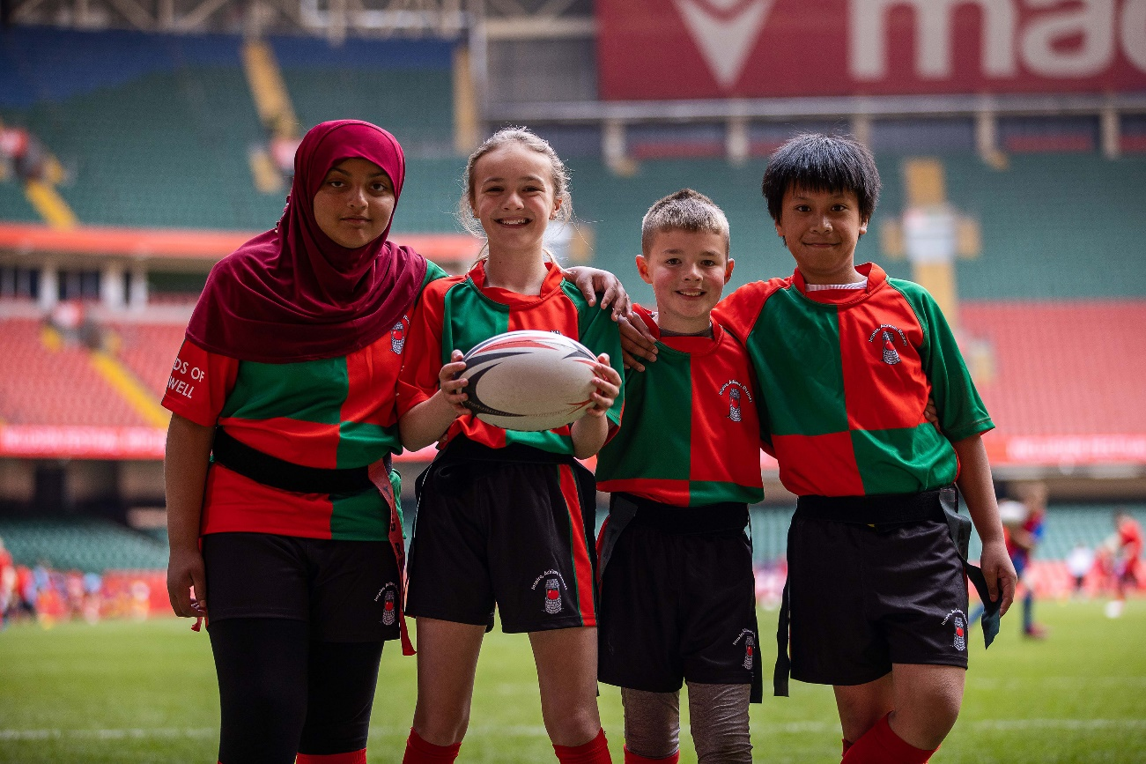
Coaching Ethnically Diverse Communities
Notes:
Introduce me, Dave and Lyndon

Slide 2
Introduction
In 2017 the WRU started active engagement in the disability space, working in partnership with Disability Sport Wales to make rugby more inclusive for people with disabilities across Wales.
In 2022 we became the first National Governing Body in Wales to achieve Insport Gold for our work with people with disabilities, it has truly become part of what we do.
Since then we have begun our journey into wider inclusion.

Slide 3
Community Department
National Areas of Focus (In order of priority):
Ethnic Minorities
Disability
LGBTQ+
Social Isolation
Notes:
Ethnic Minorities – The primary focus for the next 5 years will be geared around engagement of ethnic minority groups. Year 2 and 3 will be about developing trust with communities in each region, running sessions, events and camps on their terms, to suit their needs. Learning and adapting the way we connect and deliver to truly bring rugby to them.
Note: Women’s Rugby has it’s own team within the Community Dept that is dedicated to that area of development specifically

Slide 4
Why is it important to be inclusive?
A high proportion of people from ethnically diverse communities have experienced racism in sport.
The proportion of people that meet the recommended levels of physical activity from ethnically diverse communities is significantly lower than the national average.
2 in 5 people from ethnically diverse communities felt they have fewer opportunities to participate in sport and physical activity than someone from a white background.
Even in today’s diverse society there remains a significant under-representation of ethnically diverse communities in sport and physical activity. The issues of racism and discrimination remain with the barriers to participation and volunteering increasing. These issues and challenges need to be addressed to ensure that everyone has the opportunity and support they need to be involved with community organisations delivering sport and physical activity.
Notes:
Lets look specifically around ethnically diverse communities: (Talk through slide)
Note - It is also important to note that as part of the Equality Act 2010, organisations have a legal obligation to protect people from discrimination and harassment, including those from different ethnicities as well as other. protected characteristics.

Slide 5
Barriers
Experience of Racism
Lack of diversity
Racial stereotypes
Dress Code
Lack of cultural understanding and awareness
Mixed Gender Activity
Language
Facilities
Time of activities
Notes:
It is important to understand the different barriers which can stop people from ethnically diverse communities participating or volunteering, the common barriers that exist have been highlighted here. It is however important to recognise that people from ethnically diverse communities are not all alike, as individuals will face a wide range of unique challenges and barriers to participating or volunteering, so it is important to take time to understand the individual’s needs and accommodate these where possible.
Experience of Racism. Previous experiences of racism within sport and physical activity can negatively impact future participation and volunteering.
Lack of diversity. The lack of visible diversity amongst staff, participants, coaches and volunteers often discourages people from being involved as an organisation can be perceived as ‘non welcoming.’
Racial stereotypes. Throughout society particular stereotypes have been associated to different ethnic groups. This is a form of discrimination and can negatively impact participation and volunteering.
Dress Code. The kit people wear when participating at your sessions or events could be a barrier for both males and females of particular ethnic and faith groups.
Lack of cultural understanding and awareness of ethnic diverse communities. A lack of understanding within our organisation of different ethnic community groups, their culture and their behaviours.
Mixed gender activity. Women from particular ethnic groups and faiths will not want to participate in activities with men or will be reluctant if men are present.
Language. English may not be the first language for many ethnically diverse communities so they may not feel comfortable joining our activities or events.
Facilities. Lack of privacy in changing, showering and delivery areas can be a barrier for some ethnic groups and faiths.
Time of activities. For some groups offering activities at certain times or on specific days maybe a barrier particular if these are offered at times of pray/worship or holy days.
Note -This list is note exhaustive

Slide 6
What are the benefits of being inclusive to EDCs?
Ensuring that the WRU is inclusive to people from ethnically diverse communities can have a number of benefits, including:
Helping us to attract and retain new players and volunteers, plus creating a positive and welcoming environment.
Providing opportunities and meeting the needs of different community groups and increasing regional opportunities to participate and volunteer for those that may not feel rugby is accessible to them.
Having a player, coach and volunteer base that is representative of the local community.
Helping to break down racial stereotypes that may exist within your area of work.
Having people from ethnically diverse communities as positive/reflective role models, particularly for younger participants.
Welcoming of different faith groups. As an organisation it is important to understand the close relationship that exists between ethnicity, culture and faith when looking to make rugby more accessible.

Slide 7
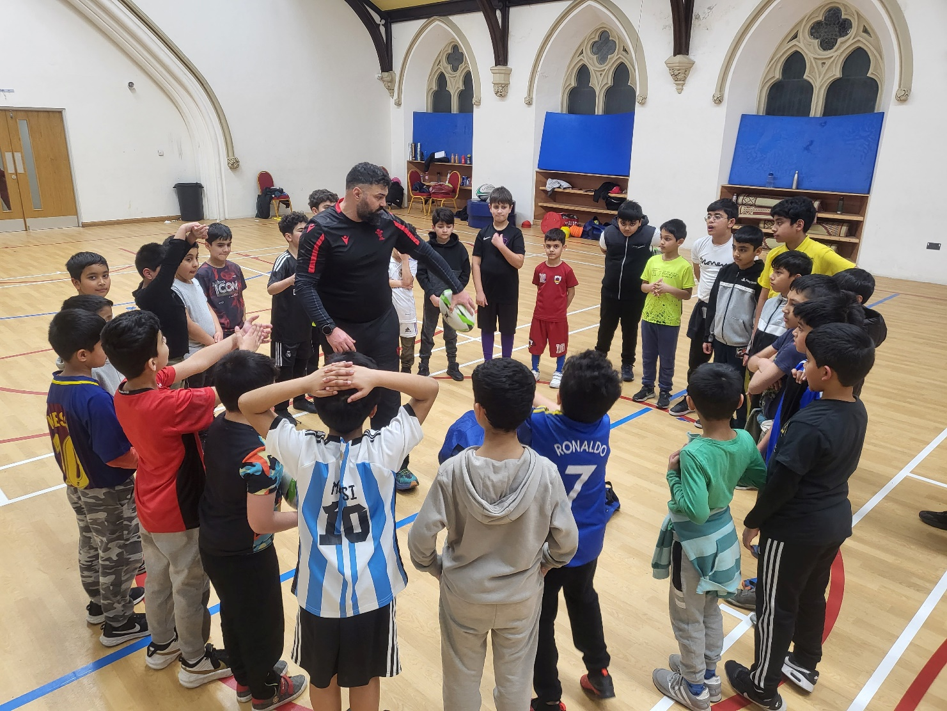
What is good Practice?
Notes:
We are still working this out, but everything must be on the terms of the participant or group and you must be consistent in order to build trust
Be aware that there is a fear factor around coaching participants outside of the traditional core demographic even now, but this is however borne out of the coach’s lack of training and hands on experience. Quite often after just one session supporting an experienced coach in this area, it will positively impact the confidence of the coach.
A good coach is always learning and pushing for a deeper understanding, so learn about cultures, understand terminology, but do not use them as a barrier to engage.
Note - Dave Roberts and DC to give a practical example

Slide 8
How Can we Achieve this? – Activity and Facilities
Talking to and engaging with participants and volunteers from ethnically diverse communities who may already be involved with our organisation or from your local community to identify their specific needs, wants and any barriers that might stop them from being involved.
Be flexible around kit and sports clothing that participants can wear. This could include allowing tracksuits to be worn instead of shorts.
Consider the timing of your offer. Many people from ethnic communities may belong to faith groups so will have particular times where they will not be able to attend sessions. Speak to the lead for groups or schools to find out what works best for them.
Connect with other local groups who have a reputation of being inclusive to seek advice on running and adapting sessions and activities. This can help make those from ethnically diverse communities more comfortable and confident to attend your sessions.
Consider offering activities for different genders if necessary.
Notes:
Key area for Hub Officers

Slide 9
How Can we Achieve this? – Activity and Facilities
People from ethnically diverse communities can favour activities that can be pursued in less competitive environments.
Involve friends and family. Use taster and drop-in sessions with ‘invite a friend or family member’ to give people the confidence to try out your activities with the support of their friends or family.
Consider if your facilities allow for sufficient privacy in activity spaces and changing areas.
Carry out research, to understand the diversity within your local community and be specific in terms of the groups within the community you wish to engage and recruit. If possible, speak to local community leaders to gain a greater insight to enable you to tailor your approach and communication.
Be willing to ask where participants would feel most comfortable to take part in sessions or events and adapt to their needs.

Slide 10
How Can we Achieve this? – Marketing & Comms
Using diverse imagery in your promotional material and communications. Which reflects your local community and the people we are seeking to attract.
Reaching out and promoting our offer to places where people from ethnically diverse communities may already meet (e.g., faith centres or local community groups).
Being specific on who we are looking to reach through your communications.
Understanding and using the correct terminology in organisational marketing and communications is important when seeking to engage with ethnically diverse communities.
Focusing promotion of the health and social benefits of participation.
Promoting the WRU’s commitment to inclusion to your local community.
Building relationships with schools, community group leaders and faith centres. You could seek their advice on adapting your offer to be more appealing for different ethnic groups.
Notes:
This is not just the responsibility of the comms team but the responsibility of each and every one of us, we can only change perceptions by being consistent in the space.

Slide 11
How Can we Achieve this? – Role Models & Events
Highlight local and national role models. Identifying and engaging with existing role models within the community will act as an enabler for participation or volunteering.
Using a diverse range of role models to promote our organisation.
Finding out from local organisations about cultural events or celebrations that are taking place such as Asian Mela, Caribbean Carnivals, Chinese New Year or Diwali and offer appropriate support.
Support anti-racism groups and campaigns at national and regional levels.
Notes:
This is not only something that needs to be driven through the community department but also driven by the wider organisation.

Slide 12
How Can we Achieve this? – Organisational
The WRU have to ensure our organisation’s operations are underpinned by inclusive practices and procedures, this can be valuable in creating a more welcoming environment for people from ethnically diverse communities.
These include:
Ensuring we have an EDI policy and equalities statement which are visible.
Developing an anti-racism and discrimination policy. The policy should have clear reporting procedures to enable your participants and volunteers to report discriminatory abuse in confidence.
Insuring there are key members within the organisation, at all levels, who are responsible for ensuring the WRU’s commitment to inclusion is upheld.
Reviewing our recruitment processes to ensure the organisation’s workforce is representative of our community.
Calling out racism and discrimination. Education for all staff, club members and volunteers on forms of racism and discrimination and encourage them to speak out if they hear or experiences incidents of this.
Notes:
Looking at the wider organisational requirements we need to ensure that our policies and procedures are also inclusive
Lyndon

Slide 13
Questions

