Slide 1
REFEREE CONFERENCE 2023 REPORT WRITING CPD
Notes:
Good Morning ladies /gents – all
I’m here from the Policy and Integrity team WRU to provide an input on Referee Report Writing - With you for around 45 mins /will give you PP and additional resources.
You may have had previous training and inputs – check how many of you have (show of hands – check when (WRU Course or where) from who?) This aimed as additional refresher / CPD for you all which I am hoping you will find useful
I will stay after so please don’t be afraid to come and talk to me if you don’t want to in this session.
In Disciplinary department we see lots of reports (Senior and age grade) and attend all the Disc panels – ultimately in the PIT we want cases dealt with robustly and expeditiously and want to stop any appeals going to disciplinary hearings which I am sure you don’t want either – where you have to attend a meeting face to face or zoom hearing and give evidence – which may be stressful
How many have had to give evidence in a disciplinary hearing?
This will give you some tools in your kitbag to help. I can tell you common themes we see with Red Card Reports– such as identification issues and lack of information in reports on offences which ultimately affects decision making for sanctions

Slide 2
TRAINING OBJECTIVES
Report Writing CPD session for Referees
Provide you with best evidence within a Referee Report
Present accurate information within the Referee Report
Have an understanding of correct terminology/language
Have all the regulations/ acts /offences
Understand the Disciplinary Process and have information to review and follow
Review Referee reports
Notes:
Hoping to give you all this information within this session - have other links and information you can take away
Won’t give you any paper (save the trees and environment) have links / where you can go for info – can add to game locker
Terminology and language often confusing!
Regs Acts offences – Sure you know more about these than me- New Act this season - World Rugby Directives -I can provide these if you need them
Disciplinary process – time lag – reasons why – some clubs don’t reply within 7 days – we chase – if don’t accept we have to arrange hearing – rely on voluntary members of panel often evening arrangements, getting all together can sometimes be tricky
Won’t discuss particular cases in this session but happy for you to chat with me after
Not touching the Disciplinary Hearing also – Videos being created for this and further information – can look at a further session if you wish think this would be useful

Slide 3
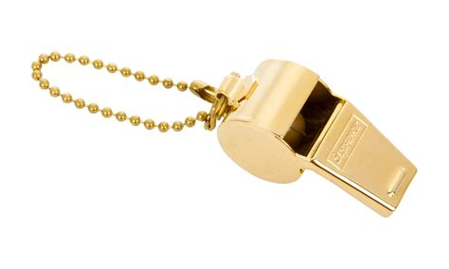
Discipline process – Red CARD CASE JOURNEY
Red Card Submitted
Charge issued
Response from Club /Player
Hold Discipline Panel
Appoint a Discipline Panel
Judgement Form Completed
Review any additional info
Discuss Cases and Make decisions
Decision sent to Club and Ref
Club / Player receive
Appeal
Red Card Incident
Notes:
This is the Process from when you blow your whistle – number of steps we all go through to end of process.
Red card issued from you – created via Ref App (or paper record), automatic charge issued to club/player (from Gamelocker), If not on App (email paper red card form) discipline do the charge and send ASAP (ref copied in), Club and Player have 7 days to respond, sometimes additional info VEO footage, other statements ref advisors, (any ref advisors here – please submit your evidence really helps), other players, Discipline team complete a Judgement form with all relevant info on about the player and evidence, Discipline Panel 3 individuals who are not associated with Clubs, ex referees (try especially to use when 9.28 offences), district members, independent members – rely on their availability often difficult to get all to coincide – Panel only go on Ref Report, discipline charge, response from club/player – if ref report doesn’t say where hit – can’t guess – can really affect their sanction - have 2 example of these within that you can see later on
Club and Player have opportunity to Appeal – go to separate hearing /discipline panel – can change decision – increase or decrease
Just to give you an example of how many red cards we had last year – 358 Senior Red Cards and 138 Age Grade Red Cards = 496 total

Slide 4
Record keeping and report writing
Notes made as soon as possible after the incident or game
Report – Factual Description of the Incident based on your Observations
ADVOKATE
Justification for your Action
Language and Terminology
Reporting via the Ref App – Submission within 48 Hours
Notes:
Good practice to make notes made as soon as possible after the incident or game – can put in your report when you have completed notes /report (time)
Looks professional when you say – as soon as practicable after the game - This will assist you in writing your report and also when you have to recall the incident
This may assist you in being credible and accurate in the evidence that you give as a witness
Report – Factual Description of the Incident based on your Observations -
Ensure that you are accurate in your report, and focus upon recalling the facts as you remember them, and try not to provide opinion i.e. I saw Red 5 kicking Blue 4 on the floor (facts) and he was doing that to purposely injure the other player (opinion)
ADVOKATE
This is an acronym that is used to accurately recall information. It relates to a stated criminal case where identification was the key issue. This is used by Police as a tool for eye witness evidence. It provides a structure to writing your report, and may be useful to Referees
Justification for your Action
Outline the reason for your decision with factual evidence
Language – Tell us Swear words not just swore at me /racist/ homophobic language tell us – (even if you haven’t heard but it’s been reported in match we still need to know this – often other code of conducts or a Citing may be reported )
Terminology – What do we think of term ‘Handbags’ – Who puts this in a report – I have seen many reports with this in – I think there may have been something in the Ref email you get each week to say ‘No Handbags’ - chatham house rules – openness of discussion –
The meaning of ‘Handbags’ - This may appear derogatory as in slang this is a fight where the protagonists are unable or unwilling to seriously hurt each other and commonly referred as a ‘handbag fight’, in reference to the way girls fight by hitting each other with their handbags.
As an organisation who has been accused of misogyny/sexism –best to avoid this terminology – have not seen it used in Womens rugby games – Can use ‘scuffle’ or other words
Other language used – please tell us if any racist terms – homophobic / islamaphobic used – had a ‘ginger bearded muslim’ comment – Unsure speak to us / Ref helpful contacts
Reporting via the Ref App – Submission within 48 Hours
The report has to be submitted to the WRU within 48 hours – last season we were still seeing some reports coming in Wednesday /Thursday/Friday – next season we will not accept these (unless exceptional reason)

Slide 5
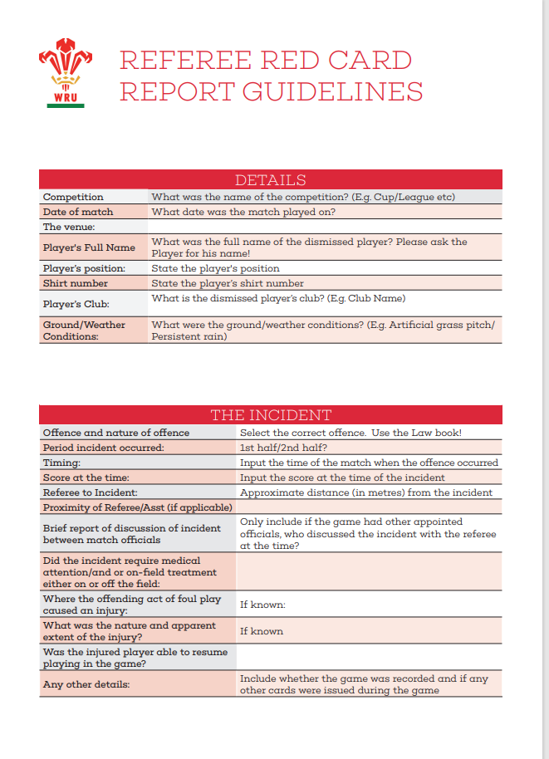
REFEREE RED CARD REPORT GUIDELINES
Specific Offence Requirements
Striking
Kicking and Stamping
Dangerous Tackling
Verbal Abuse
Other Relevant and Important Information i.e. Provocation, Retaliation, Self Defence, Explanation, Remorse etc.
Notes:
Updated Guide. We have copies of this guide for you 3 pages and a Verbal Abuse document – will add to Game locker Ref section for you – can forward to you all with copies of PP
Referees also need to report any significant incidents – Match Abandoned
Examples of this are Racial or Homophobic Abuse, Serious Injury to a Player, Mass Brawl or anything that would attract media interest – Social media often flags these things before we come into work on Monday
Mention new legislation from World Rugby Under Law 9.20 (d): (Think you covered this yesterday?)
A player may lever the jackler out of the contest at the ruck but must not drop their weight onto them or target the lower limbs.
Low-end: 2 weeks/matches Mid-range: 6 weeks/matches Top-end: 10+ weeks/matches Max: 52 weeks/matches
Give link to WRU Disciplinary Regs

Slide 6
Verbal abuse of match officials – 5 offences
Law 9.28: Disrespect the authority of a Match Official
This may include:
• Questioning a decision of the match official
• Sarcastic gestures in response to a match official decision.
• Refusing to listen or return to the Referee.
Law 9.28: Verbal Abuse of a Match Official
• The Player/Person uses foul or offensive language in comments aimed directly at a Match Official.
• Includes any attack upon the integrity of the Match Official regardless of whether or not this is accompanied by foul or offensive language i.e calling a referee a cheat.
• As an illustrative example, “that’s a fucking joke”, that would constitute disrespecting the authority of the referee but if the player’s response was to shout directly at the Match Official, “You’re a fucking joke” that would amount to abuse.
Notes:
Look at 9.28 Offences Any of you not experienced any of these offences?
Majority of these offences can be committed by player /Coach /Spectator
Don’t worry too much about which offence as we can review and amend
ANY ABUSE OF MO IS NOT ACCEPTABLE – WE DO NOT TOLERATE ABUSE OF MATCH OFFICIALS
Some of the initiatives the Policy and Integrity team have taken include - Directives sent to clubs, Posters respect the ref sent to clubs, Education to Clubs, Ref Cameras and posters for clubs to place when these are being used, having ex referees on Discipline Panels, Top end Sanctions, Information on our website of sanctions issued (sanatised) – ultimately need a change of behaviour from all to eradicate this
WE HAPPY TO WORK WITH YOU IF YOU HAVE ANY IDEAS TO DETER STOP THIS!

Slide 7
Verbal abuse of match official
Law 9.28: Using threatening actions or words towards Match Officials
• This occurs where a specific threat is made to a Match Official either verbally or by physical gesture. As an illustrative example “I’m going to wait for you after the game”.
“I am going to fucking have you after the game”. “I know where you live”.
Law 9.28: Making physical contact with a Match Official
• Non-intentional contact with the referee which is more than merely accidental.
• Pushing or moving the Referee out of the way to get to a breakdown situation.
• Law 9.28: Physical abuse of a Match Official
• The most serious level of offending.
• Intentionally/deliberate makes physical contact with the Match Official
Notes:
Give some figures on physical abuse – worst type of offending - how many have we seen this year? – Red Card Cases Senior 39 Age grade 17 cases

Slide 8
Head contact principles
In relation to the new tackle height directive being issued for next season, Referees (in the event of a red card being issued) to provide a rationale by applying the HCP within their red card reports. referring to the HCP (steps followed) so that the Panel can determine whether the offending reaches the red card threshold
Notes:
Will add this to Game locker for you – THERE ARE VIDEOS AND INFORMATION ALREADY ADDED

Slide 9
Head contact process
Notes:
The Head Contact Process is a Law Application Guideline. Under 9.11, the referee is always entitled to issue a red or yellow card for anything deemed to be reckless or dangerous. However, this process is intended to aid consistency in the application of
sanctions by providing guidance on how contact with the head should be approached by match officials and disciplinary personnel.

Slide 10
Notes:
Process questions and considerations
1. Has head contact occurred?
Head contact includes neck and throat area
2. Was there foul play?
Considerations:
• Intentional
• Reckless
• Avoidable – e.g. the defender is always upright
3. What was the degree of danger?
Considerations include:
• Direct vs indirect contact
• High force vs low force
• Dynamic
4. Is there any mitigation?
Considerations include:
• Line of sight
• Sudden and significant drop or movement
• Clear attempt to reduce height
• Level of control
• Passive tackler
Mitigation will not apply for intentional or always-illegal acts of foul play

Slide 11
Examples of Ref reports
1) A full on tough game where two teams were at each other from the start.
On the 70-minute, after the whistle had blown for a penalty to xxxxxx, number x for xxxxxxx xxxxx xxxxx punched a xxxxxx player whilst they were
on the floor.
2) Tackle and counter ruck, between 22m and 10m into XXXXX half 78min stop start.
XXXXXXXX engaged in physical retaliations. No clear view to who through first punch, only XX continued multiple punches towards upper body and head of opponent.
Notes:
2 Examples for you - What do we think of this? Does this have enough detail? As a Panel member what questions do you think they are going to ask?
Where did he/she punch?
How hard?
Did punches connect
Any injuries
What do you think the Result of the Discipline Panel was for this player?
Result Player had low entry sanction (2 weeks) if clearer (hit on head – minimum of 6 weeks)

Slide 12
Good referees report
SET THE SCENE
GIVE YOUR EXPERIENCE & IF WEARING REF CAMERA
YOUR APPOINTMENT – DID ANYONE FROM CLUB CONTACT YOU
WEATHER/CONDITIONS/ PITCH SURROUNDING AREA
DID YOU GET TEAM SHEETS, YOUR TEAM TALKS
TIME OF KO/ HOW MANY THERE / TEAM COLOURS
IF GIVING INFO ON MATCH KEEP FACTUAL AND RELEVANT
THE INCIDENT/ WHERE ON BODY/ONCE/TWICE /FORCE/ SWEARING USE WORDS
THE FOUL /OFFENCE- YOUR DISTANCE AWAY AND VIEW OF THIS
WHAT DID YOU DO
Notes:
15 points to a good report with best evidence /accurate – will provide a template for this for you
Team colours really important for when we view any video footage!

Slide 13
Continuation of good referees report
JUSTIFICATION & ISSUE OF RED CARD HOW YOU IDENTIFIED PLAYER THEIR RESPONSE (applying the HCP if head contact)
ANY INJURIES OF OTHER PLAYER – DESCRIBE & RESULT OF THIS
CONCLUSION OF GAME – CONFIRMATION OF RED CARDED PLAYER
IF YOU WENT TO CLUB HOUSE ANY RESPONSE
FINAL RESULT / WHEN YOU COMPLETED REPORT/ IF MATCH ABANDONED – ANY OTHER ISSUES

Slide 14
No ref no
game
T
Notes:
Thank you from Discipline Team – Give some figures amounts of reports – 691 cases this season
358 Senior Red Cards, 66 Senior Codes of Conduct, 138 Age grade red Cards, 110 age grade codes of conduct, 13 Senior Citing, 6 age grade citing cases = 691 ( last season 565 cases - increase of 126 cases)
and Reminder to put your reports in on time (48 hours) as next season we going to be strict with this

Slide 15
Key contacts
WRU Policy and Integrity
disciplinarydept@wru.wales
Leah Thomas lthomas@wru.wales
Mandi Venn mvenn@wru.wales
Tony Rees arees@wru.wales
WRU Integrity Line
Telephone - 029 20 822 200
E-mail – integrity@wru.wales
WSRUR Disciplinary Support
Wil Evans - wil.evans49@gmail.com
WRU Referee Support
Sean Brickell – 07900 941912
Jon Mason – 07867 189951
Paul Adams - 07725 069252
Notes:
Additional support for you all

