Slide 1
Equality Diversity and Inclusion (EDI) at WRU

Slide 2
The WRU Commitment
The WRU are committed to providing a game for all.
Our aim is to provide a safe, welcoming and inclusive environment for our rugby family, across Wales.
It is the responsibility of the WRU to lead Welsh rugby, impress our values on our community and ensure everyone is treated with dignity and respect.

Slide 3
Our priorities
The WRU will provide a sector leading approach to inclusion, to ensure we create exceptional experiences for everyone in our game.
We are committed to providing a game for all, free from bullying, harassment and discrimination.
Our focus between now and 2028 will be providing opportunities for:
Women and Girls
Ethnically diverse communities
Disabled people
Lower-socio economic communities

Slide 4
WRU EDI Policy
The WRU aims for its workforce, and rugby in Wales, to be representative of its communities.
To achieve our ambitions be a People First employer and provide a Jersey for All, we will:
Take a zero tolerance approach to discrimination, bullying and harassment.
Provide education and training to our staff, Board, Council, volunteers and stakeholders across Welsh rugby.
Collaborate with partners, stakeholders and subject matter experts to improve EDI outcomes and remove barriers to rugby in Wales.
Data led insight to continually monitor, adapt and approve to ensure EDI progress.
Communicate our progress across Welsh Rugby

Slide 5
Equality act (2010)
What are the 9 protected characteristics, covered by law in the UK?
Think about groups that have been treated less favorably, in society.
It is against the law to discriminate against anyone, based on these 9 characteristics.

Slide 6
THE EQUALITY ACT 2010
PROTECTED CHARACTERISTICS
AGE
DISABILITY
GENDER REASSIGNMENT
MARRIAGE AND CIVIL PARTNERSHIP
PREGNANCY AND MATERNITY
RACE
RELIGION OR BELIEF
SEX (GENDER)
SEXUAL ORIENTATION
THE EQUALITY ACT 2010
PROTECTED CHARACTERISTICS
1
2
3
4
5
6
7
8
9
Notes:
Tutors Notes:
On this slide delegates will look further as what the equality is and the protected characteristics. The Equality Act 2010 brings together all legal requirements relating to Equality into one single Act
The key message behind the Act is that everyone has the right to be treated fairly at work or when using a service.
The Act protects against discrimination on the following grounds:
Age
Disability
Gender Reassignment
Marriage and Civil Partnership
Pregnancy and Maternity
Race
Religion of Belief
Sex (Gender)
Sexual Orientation
These are described as Protected Characteristics.
On this slide, as a tutor you have the opportunity to facilitate discussions.
Group Activity: As a tutor you may want to break the delegates into small groups to see how many of the protected characteristics they can name or alternatively, you may wish to keep the delegates in one group and do the same.

Slide 7
Why do we talk about EDI?
Talk about difference
More empathy
Less chance of discrimination or bias
Greater feeling of inclusion

Slide 8
A Collective Responsibility

Slide 9
A Collective Responsibility - support our ambitions
Report all sexist, racist, ableist and homophobic abuse
Don’t walk past bullying, harassment or discrimination
Don’t be a Bystander –Tackle this Together
Lead by example
Check your own language and set the standards for your Club and/or Team
Challenge Players, Coaches, Officials on the language used in training and during the match
Value and Respect your Teammates, the Match Officials, Players and Opposition
Take Action and Challenge inappropriate language and stereotypes

Slide 10
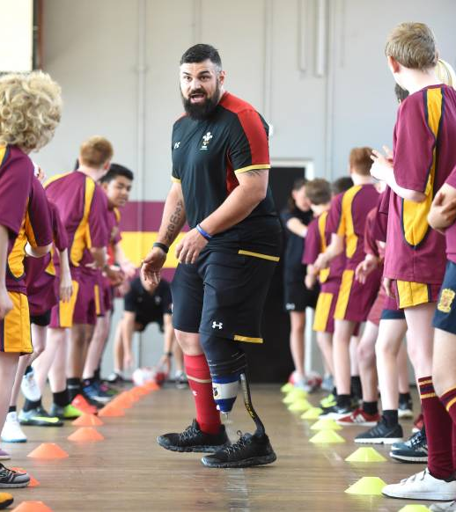
Education and engagement
Speak to your Players about appropriate language and how such language can impact upon other Players.
Engage in learning from WRU and partners such as:
Dysgu WRU
Women in Sport
Show Racism the Red Card
Reach out to the Welsh Rugby Union – we can signpost to appropriate education.

Slide 11
Social media
Be mindful about the language used – be inclusive and thoughtful about the language and opinions expressed online – be respectful towards Teammates, Opposition Players, Coaches and Match Officials.
Promote your Club and Team in a positive and inclusive way.
Challenge and Report any online discrimination.

Slide 12
The wru codes of conduct
The Codes prohibits ANY abuse based upon protected characteristics:
Age,
Disability
Gender reassignment
Race (including colour, nationality, ethnic or national origins)
Religion or belief
Sex
Sexual orientation.

Slide 13
Match Day reporting
If you are subject to or witness any discriminatory abuse during a match, report it ASAP to the Referee, a Club Official, a Coach or (if applicable) a Club steward.
Report
ASAP

Slide 14
reporting to wru integrity team
It is essential that the Integrity Team are made aware of all discriminatory complaints as soon as possible so that an appropriate investigation can be undertaken.
Report and Engage with the WRU Integrity Team as soon as possible.
Integrity Mailbox
integrity@wru.wales
Guidance around submitting a Complaint can be found here
Notes should be made as soon as possible after the incident. This will assist in writing a complaint and/or witness statement.
Write down what you saw, the exact words that you heard, the distance that you were from the incident and any other relevant information (including, if possible, the identity of the accused or a description of the accused).

Slide 15
Welfare Support
Welfare Support is also available for those victim to any abuse.
Please reach out to the WRU Integrity Team, who will be able to signpost to appropriate support networks.

