Slide 1
REFEREE CONFERENCE 2023 REPORT WRITING CPD

Slide 2
TRAINING OBJECTIVES
Report Writing CPD session for Referees
Provide you with best evidence within a Referee Report
Present accurate information within the Referee Report
Have an understanding of correct terminology/language
Have all the regulations/ acts /offences
Understand the Disciplinary Process and have information to review and follow
Review Referee reports

Slide 3
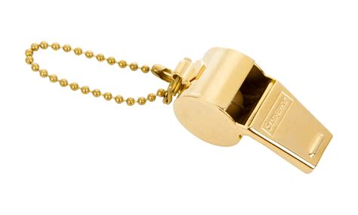
Discipline process – Red CARD CASE JOURNEY
Red Card Submitted
Charge issued
Response from Club /Player
Hold Discipline Panel
Appoint a Discipline Panel
Judgement Form Completed
Review any additional info
Discuss Cases and Make decisions
Decision sent to Club and Ref
Club / Player receive
Appeal
Red Card Incident

Slide 4
Record keeping and report writing
Notes made as soon as possible after the incident or game
Report – Factual Description of the Incident based on your Observations
ADVOKATE
Justification for your Action
Language and Terminology
Reporting via the Ref App – Submission within 48 Hours

Slide 5
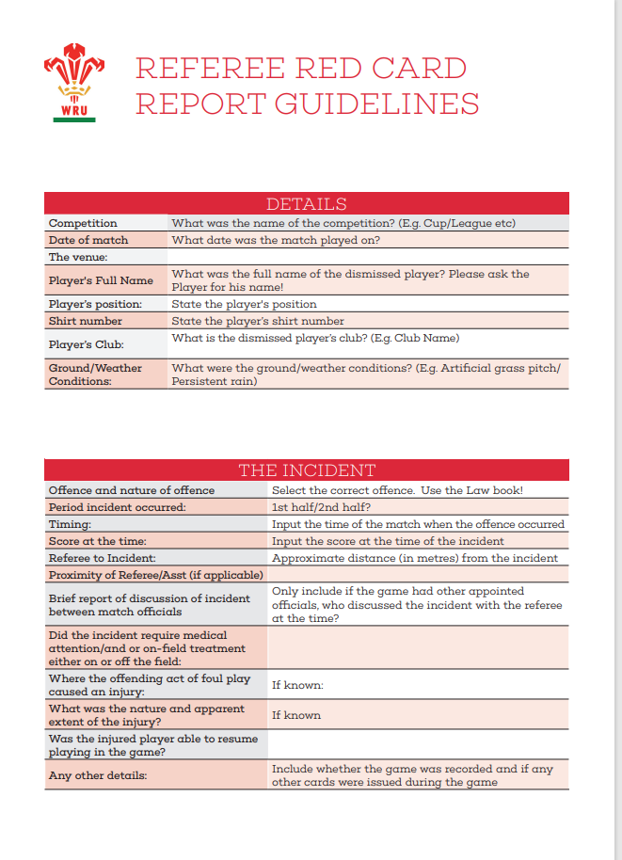
REFEREE RED CARD REPORT GUIDELINES
Specific Offence Requirements
Striking
Kicking and Stamping
Dangerous Tackling
Verbal Abuse
Other Relevant and Important Information i.e. Provocation, Retaliation, Self Defence, Explanation, Remorse etc.

Slide 6
Verbal abuse of match officials – 5 offences
Law 9.28: Disrespect the authority of a Match Official
This may include:
• Questioning a decision of the match official
• Sarcastic gestures in response to a match official decision.
• Refusing to listen or return to the Referee.
Law 9.28: Verbal Abuse of a Match Official
• The Player/Person uses foul or offensive language in comments aimed directly at a Match Official.
• Includes any attack upon the integrity of the Match Official regardless of whether or not this is accompanied by foul or offensive language i.e calling a referee a cheat.
• As an illustrative example, “that’s a fucking joke”, that would constitute disrespecting the authority of the referee but if the player’s response was to shout directly at the Match Official, “You’re a fucking joke” that would amount to abuse.

Slide 7
Verbal abuse of match official
Law 9.28: Using threatening actions or words towards Match Officials
• This occurs where a specific threat is made to a Match Official either verbally or by physical gesture. As an illustrative example “I’m going to wait for you after the game”.
“I am going to fucking have you after the game”. “I know where you live”.
Law 9.28: Making physical contact with a Match Official
• Non-intentional contact with the referee which is more than merely accidental.
• Pushing or moving the Referee out of the way to get to a breakdown situation.
• Law 9.28: Physical abuse of a Match Official
• The most serious level of offending.
• Intentionally/deliberate makes physical contact with the Match Official

Slide 8
Head contact principles
In relation to the new tackle height directive being issued for next season, Referees (in the event of a red card being issued) to provide a rationale by applying the HCP within their red card reports. referring to the HCP (steps followed) so that the Panel can determine whether the offending reaches the red card threshold

Slide 9
Head contact process

Slide 11
Examples of Ref reports
1) A full on tough game where two teams were at each other from the start.
On the 70-minute, after the whistle had blown for a penalty to xxxxxx, number x for xxxxxxx xxxxx xxxxx punched a xxxxxx player whilst they were
on the floor.
2) Tackle and counter ruck, between 22m and 10m into XXXXX half 78min stop start.
XXXXXXXX engaged in physical retaliations. No clear view to who through first punch, only XX continued multiple punches towards upper body and head of opponent.

Slide 12
Good referees report
SET THE SCENE
GIVE YOUR EXPERIENCE & IF WEARING REF CAMERA
YOUR APPOINTMENT – DID ANYONE FROM CLUB CONTACT YOU
WEATHER/CONDITIONS/ PITCH SURROUNDING AREA
DID YOU GET TEAM SHEETS, YOUR TEAM TALKS
TIME OF KO/ HOW MANY THERE / TEAM COLOURS
IF GIVING INFO ON MATCH KEEP FACTUAL AND RELEVANT
THE INCIDENT/ WHERE ON BODY/ONCE/TWICE /FORCE/ SWEARING USE WORDS
THE FOUL /OFFENCE- YOUR DISTANCE AWAY AND VIEW OF THIS
WHAT DID YOU DO

Slide 13
Continuation of good referees report
JUSTIFICATION & ISSUE OF RED CARD HOW YOU IDENTIFIED PLAYER THEIR RESPONSE (applying the HCP if head contact)
ANY INJURIES OF OTHER PLAYER – DESCRIBE & RESULT OF THIS
CONCLUSION OF GAME – CONFIRMATION OF RED CARDED PLAYER
IF YOU WENT TO CLUB HOUSE ANY RESPONSE
FINAL RESULT / WHEN YOU COMPLETED REPORT/ IF MATCH ABANDONED – ANY OTHER ISSUES

Slide 14
Thanks
For all you
Do
No ref no
game

Slide 15
Key contacts
WRU Policy and Integrity
disciplinarydept@wru.wales
Leah Thomas lthomas@wru.wales
Mandi Venn mvenn@wru.wales
Tony Rees arees@wru.wales
WRU Integrity Line
Telephone - 029 20 822 200
E-mail – integrity@wru.wales
WSRUR Disciplinary Support
Wil Evans - wil.evans49@gmail.com
WRU Referee Support
Sean Brickell – 07900 941912
Jon Mason – 07867 189951
Paul Adams - 07725 069252

