Slide 1
Educator IV

Slide 2
Quality Assurance
Quality assurance is the process the WRU undertakes to ensure their educational offerings are up to the highest standards.
This process prevents mistakes, addresses any issues that arise, and ensures consistency across our educator workforce.
The WRU has created a NEW robust system that evaluates the various offerings and provides guidance, development and support.

Slide 3
Quality Assurance
A quality assurance process sets clear expectations and standards from the start.
There’s less room for error or misunderstandings when people know what is expected of them.
When educators understand what’s expected of them, they are less stressed and better able to focus on meeting established standards.
The positive impact of quality assurance also extends to their trust in us.
Enacting quality assurance processes proves to educators that “quality” isn’t just an empty buzzword, but there are systems in place to enable all to grow and thrive.

Slide 4
QUALITY ASSURANCE
Observations
Opportunity to self-reflect
Supported development plan

Slide 5
Observation Domains
Theory Delivery Presentations that are delivered inside or online.
Practical Delivery On the playing field or workshops.
Assessment The review of a participant's performance against a set of criteria.
Subject Knowledge The knowledge that the deliverer has around their topic
As part of the WRU’s quality assurance process you will be monitored at times when delivering. This will be across all the WRU educational offerings.
A set of standardised competencies have been established and have been broken down into four domains.

Slide 6
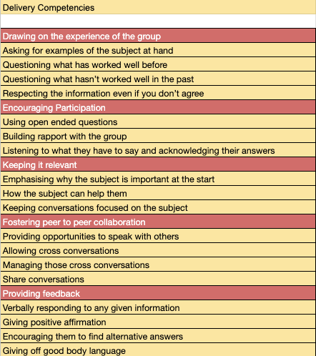
Theory – Classroom presentations
The theory area has five sections of competencies, and you could potentially be observed over multiple presentations over a course duration or even over more than one course to get your competencies ticked off!
This just gives us more opportunity to support and develop you!

Slide 7
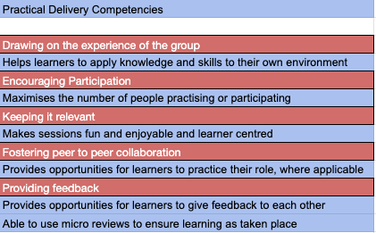
Practical – Outdoor session
The practical has not as many competencies as the theory section, and your observer would be able to complete this in one session.
This will happen more than once a year if possible!

Slide 8
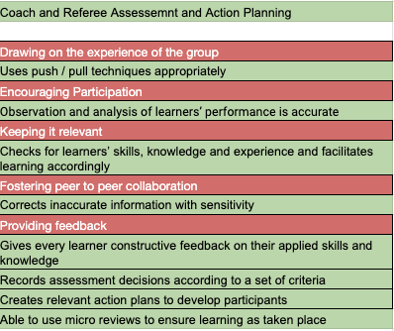
Assessment – The review
The assessment domain currently is only used on coaching and referee courses – generally on the L2 and L3 courses.
You could also be filmed giving a review so that you can watch back and reflect on your performance.

Slide 9
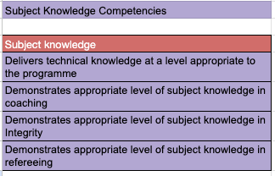
Subject knowledge
The final domain is subject knowledge, this gives us an insight into your development needs and aids us in deciding what opportunities you should be given.
It will also give us insight into how we are providing support through tutor notes, are you sticking to them or going off script.
Finally, it will aid us in developing more continuous development opportunities through analysis of your feedback.

Slide 10
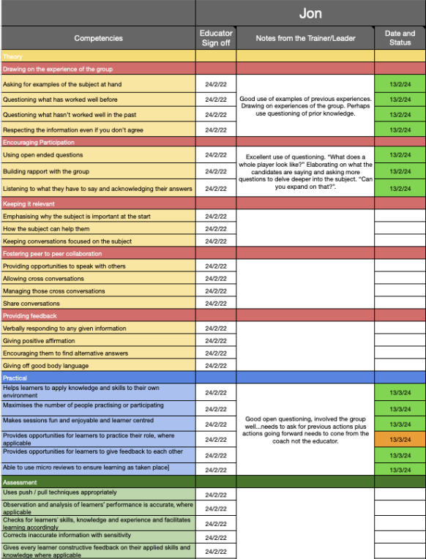
Record of achievement & Development
On completion of any observation, it will be recorded, and you will have access to the feedback via the google drive folder.
Everyone will be at different levels of development depending on their delivery schedule, and the opportunity to have had an observation.
This should be seen as a two-way process, and we encourage you to ask for observations so that you can develop your skills.
Notes:
You will see in the column with the name that this person has had a couple of IV’s and has been traffic lighted on their progressions, orange to show limited evidence had been performed and you will look at this again

Slide 11
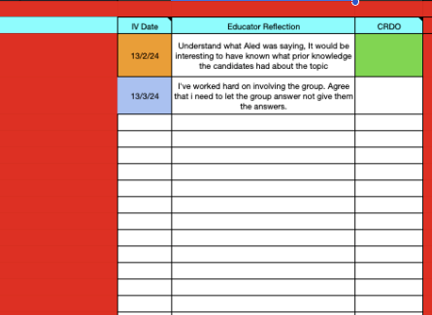
Reflection – What you must do!
You must reflect after every observation,
and the process we will use is as follows.
The person who performs the IV will fill out a google form. (this happens in action)
The CDO will take that information within 48hrs and will upload it to your personal ROA (slide previously)
On the same spreadsheet there is a space for you to reflect. (on action)
Use the colour system of Theory – Orange, Practical – Blue, Assessment – Green to show what area you are reflecting on.
Finally, the CDO will colour this green to acknowledge they have read and will follow up if needed.

Slide 12
EDUCATOR DEVELOPMENT CENTRE
The Educator Development Centre will be found on the Game Locker
It will contain the course presentations, tutor notes, training videos in their specific domain.
You will find the links to your Feedback

Slide 13
Review
What more support do you require if any?
Does this make sense?
What do you think?

Slide 14
Thanks for jumping on tonight
Questions

